Slide 1
Atigun Pass SNOTEL
Photos 10-24-22

Slide 3
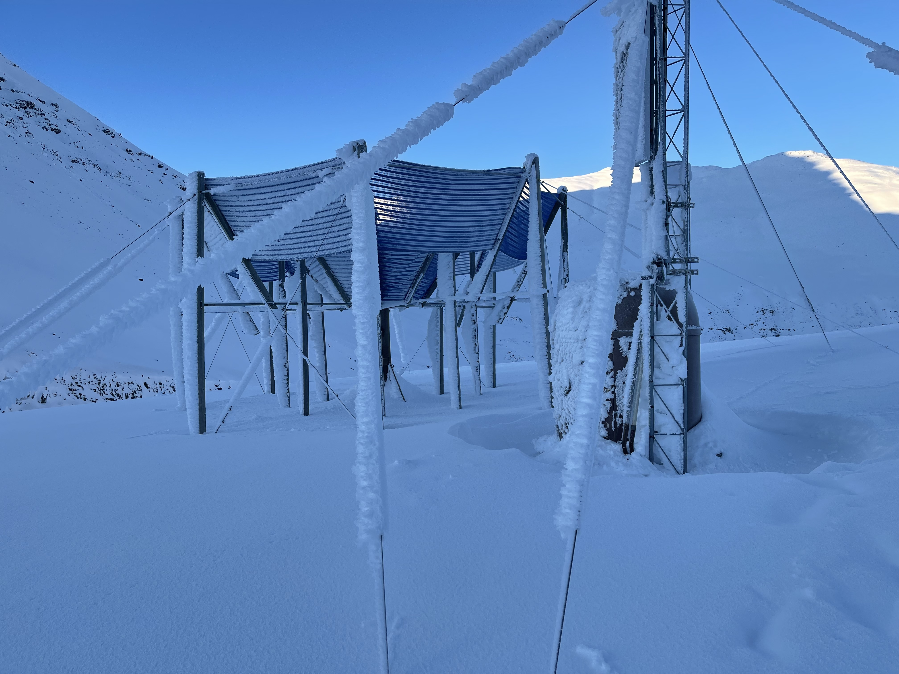
Anemometer Tower
Right Foreground

Slide 4
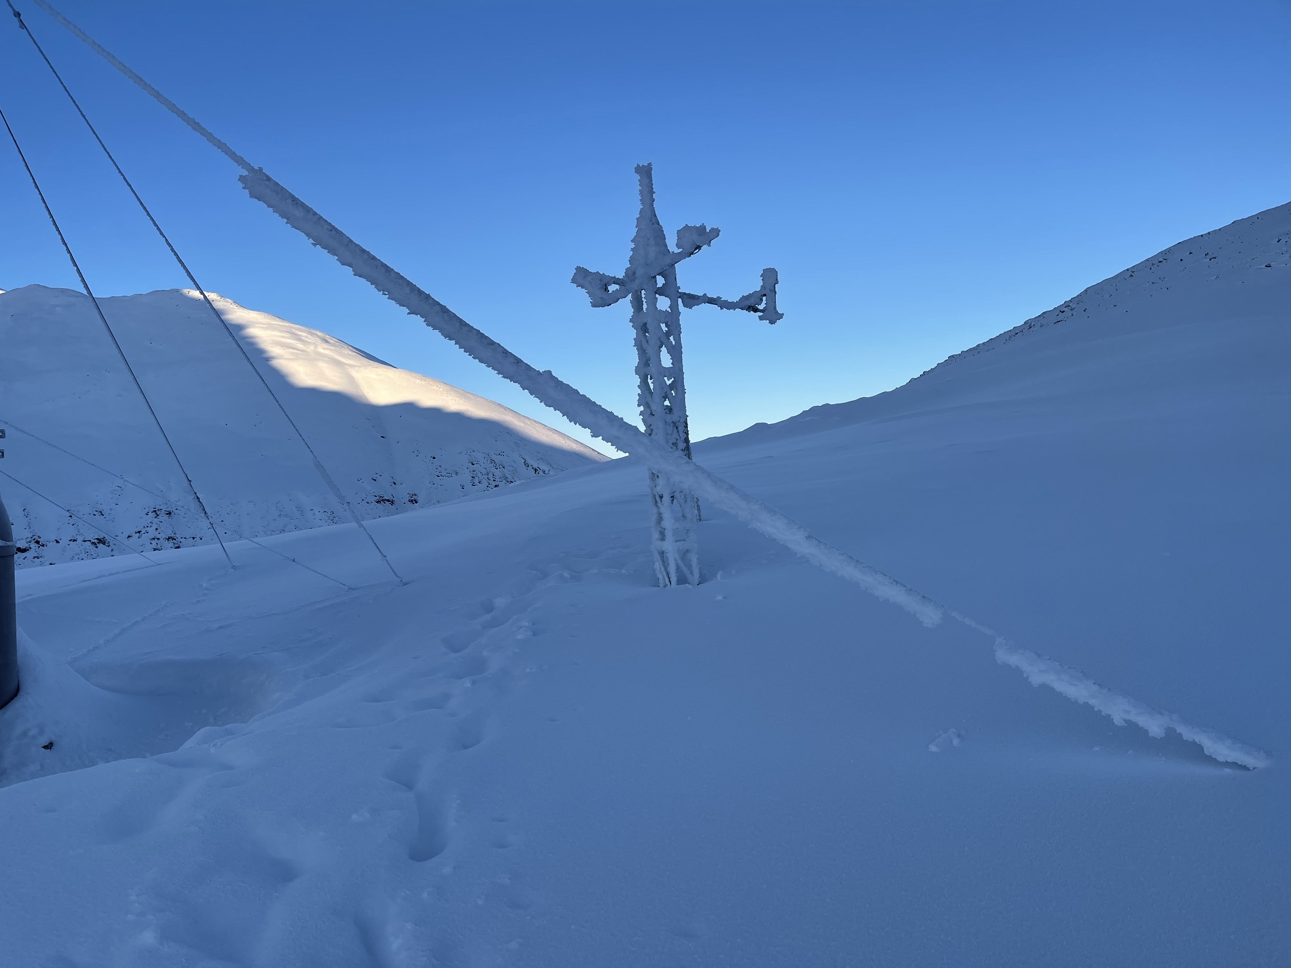
Snow Depth
Tower
Anemometer Tower
At Left edge of photo

Slide 5
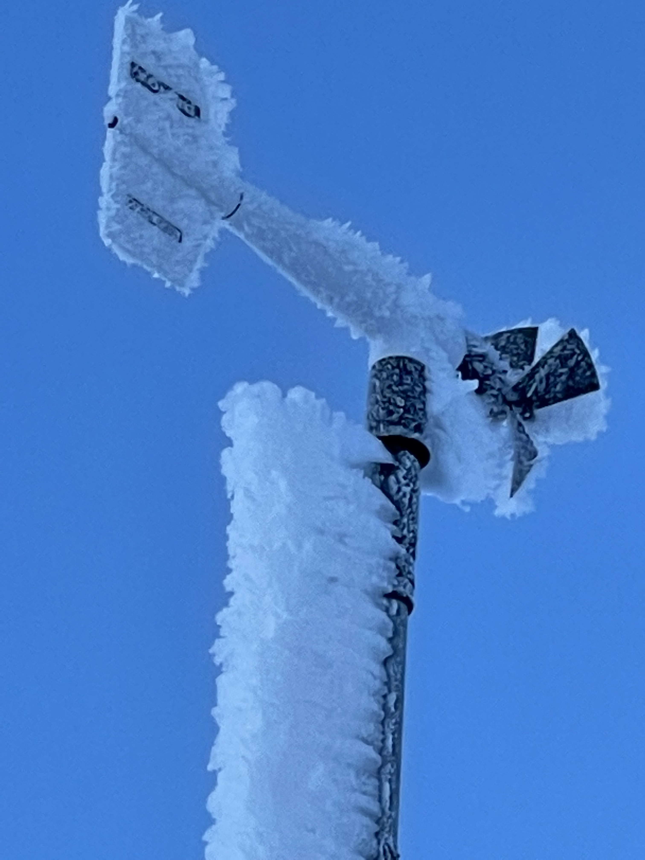

Slide 6
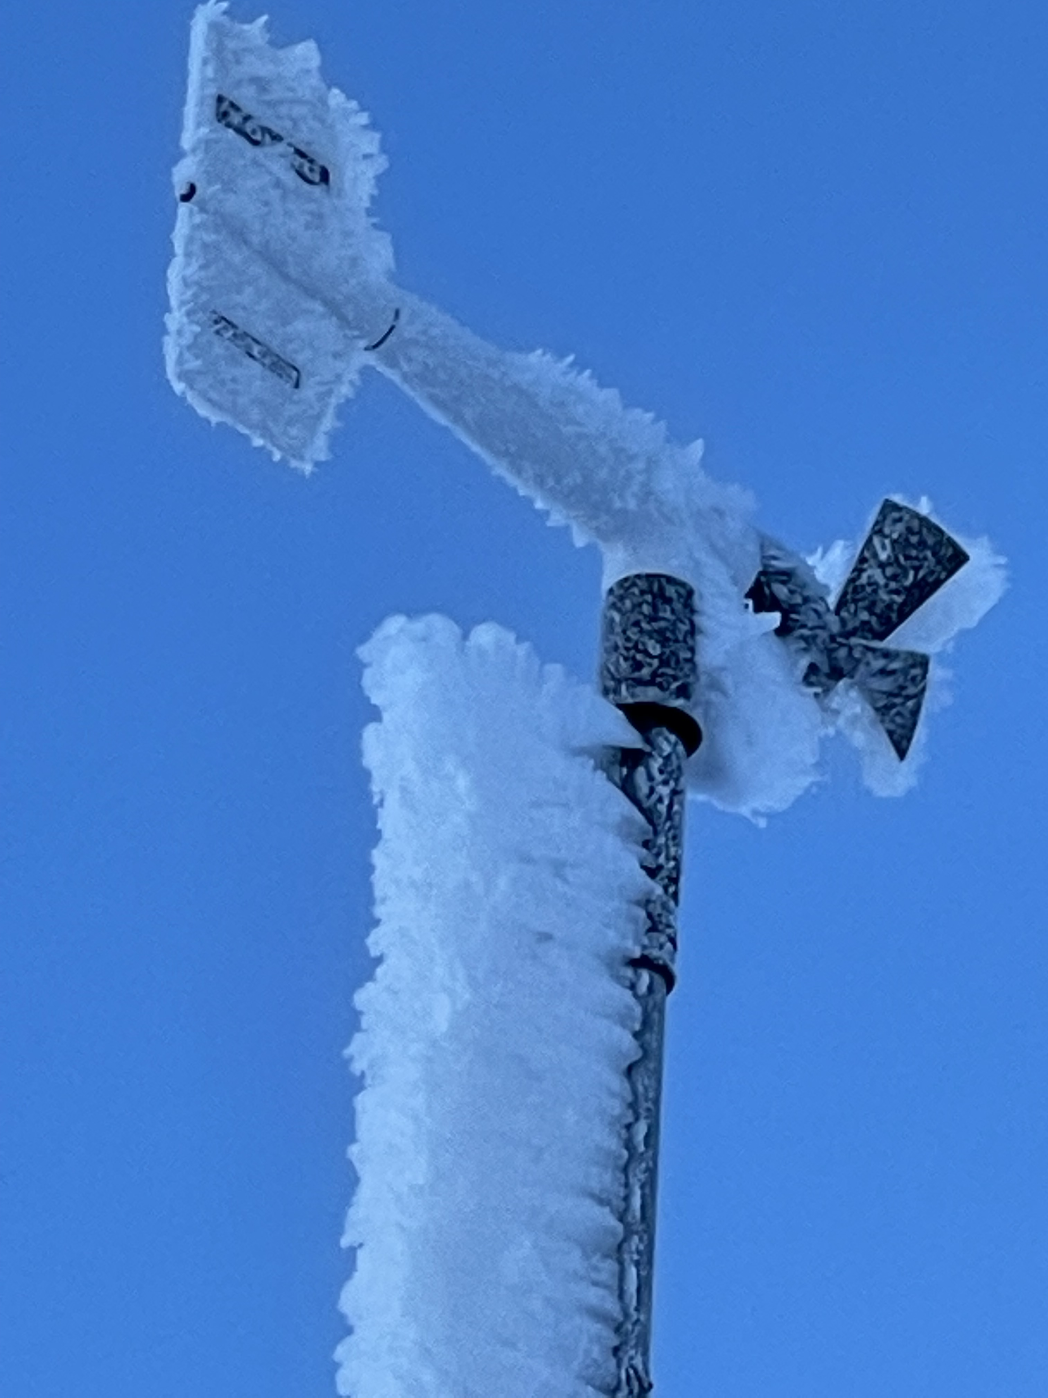

Slide 7
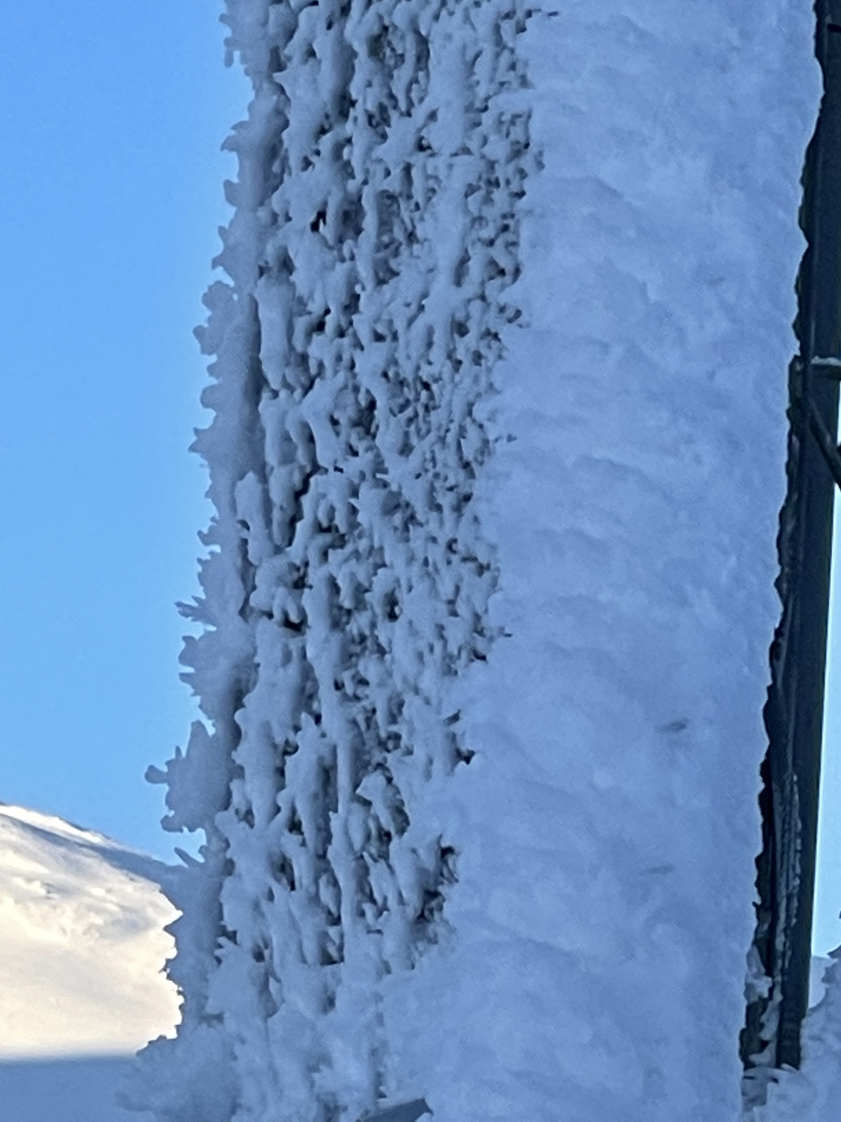
Solar Panel
On
Anemometer Tower

Slide 8
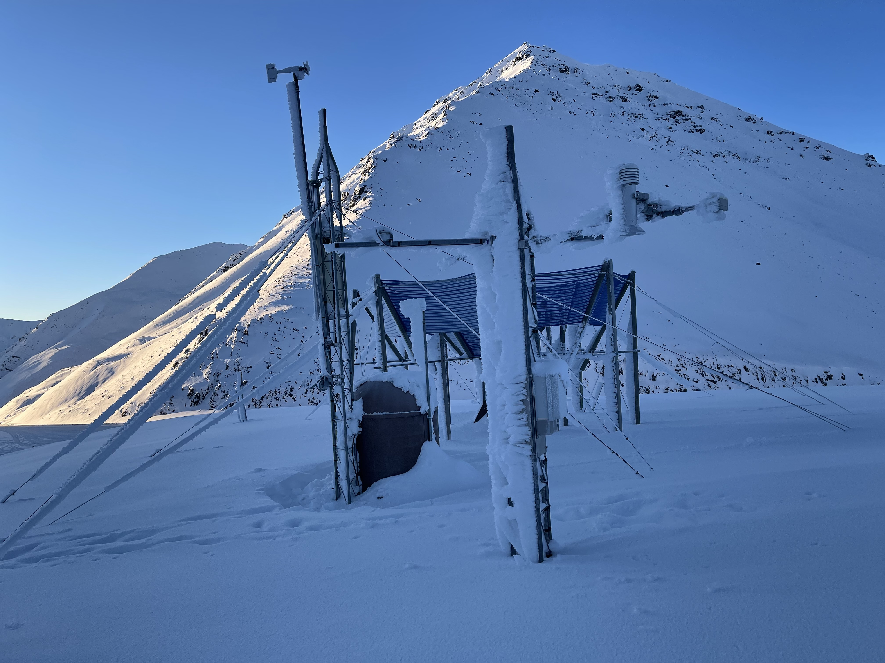
The WHOLE Station
ATGA2
Snow Depth Tower
Closest
Anemometer Tower
Right next to the
Battery & Instrument
Enclosure
View looking to NW
(towards the road)

Slide 9
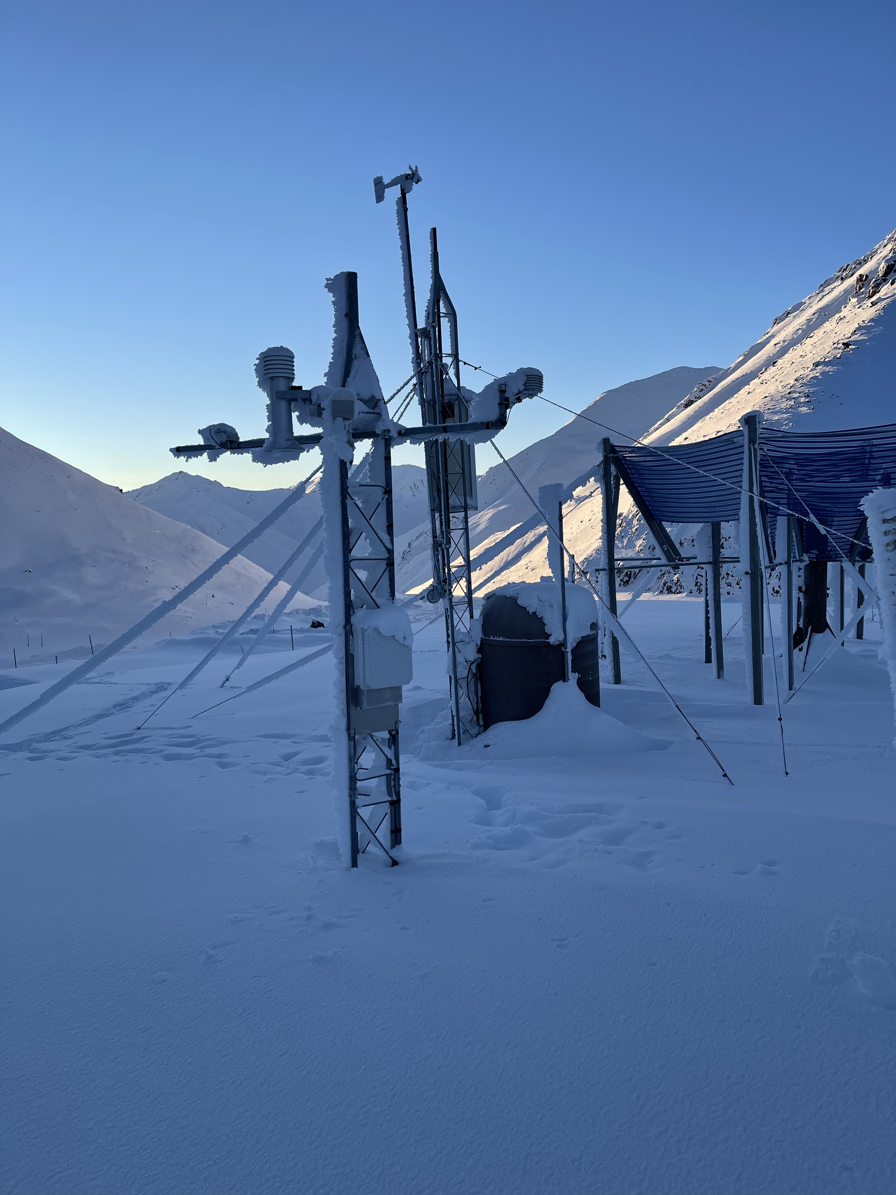
View Towards
AAW01

Slide 10
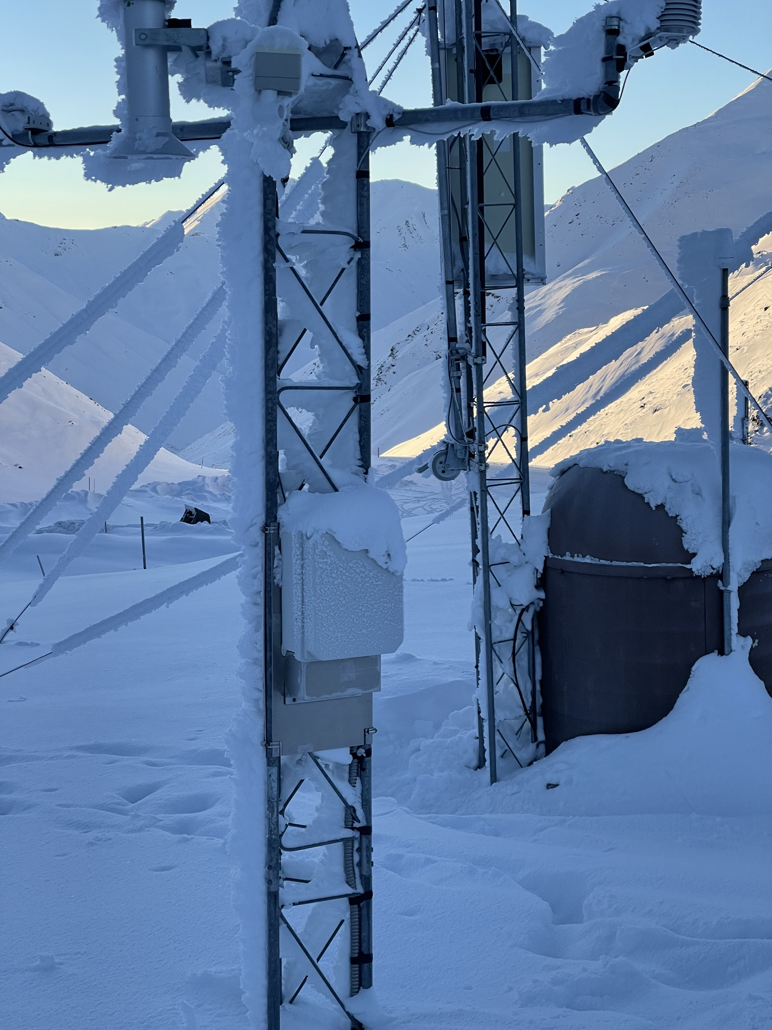
View Towards
AAW01

Slide 11
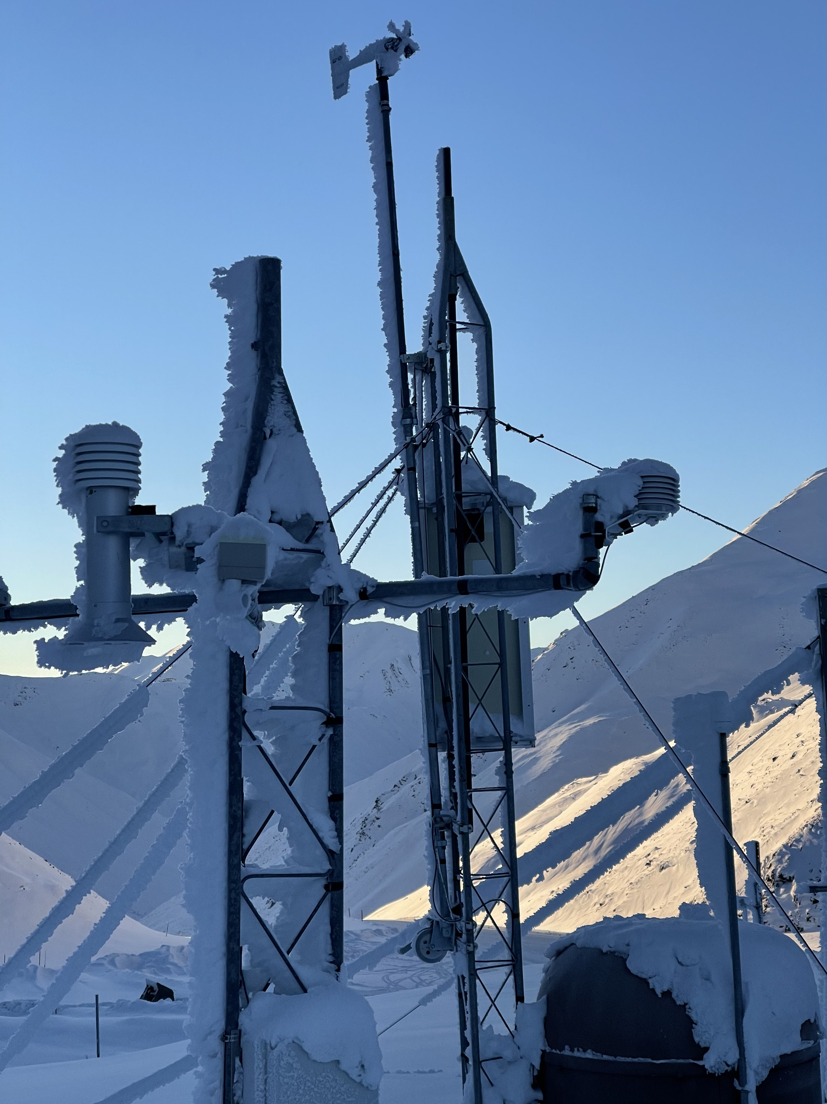
View Towards
AAW01

Slide 12
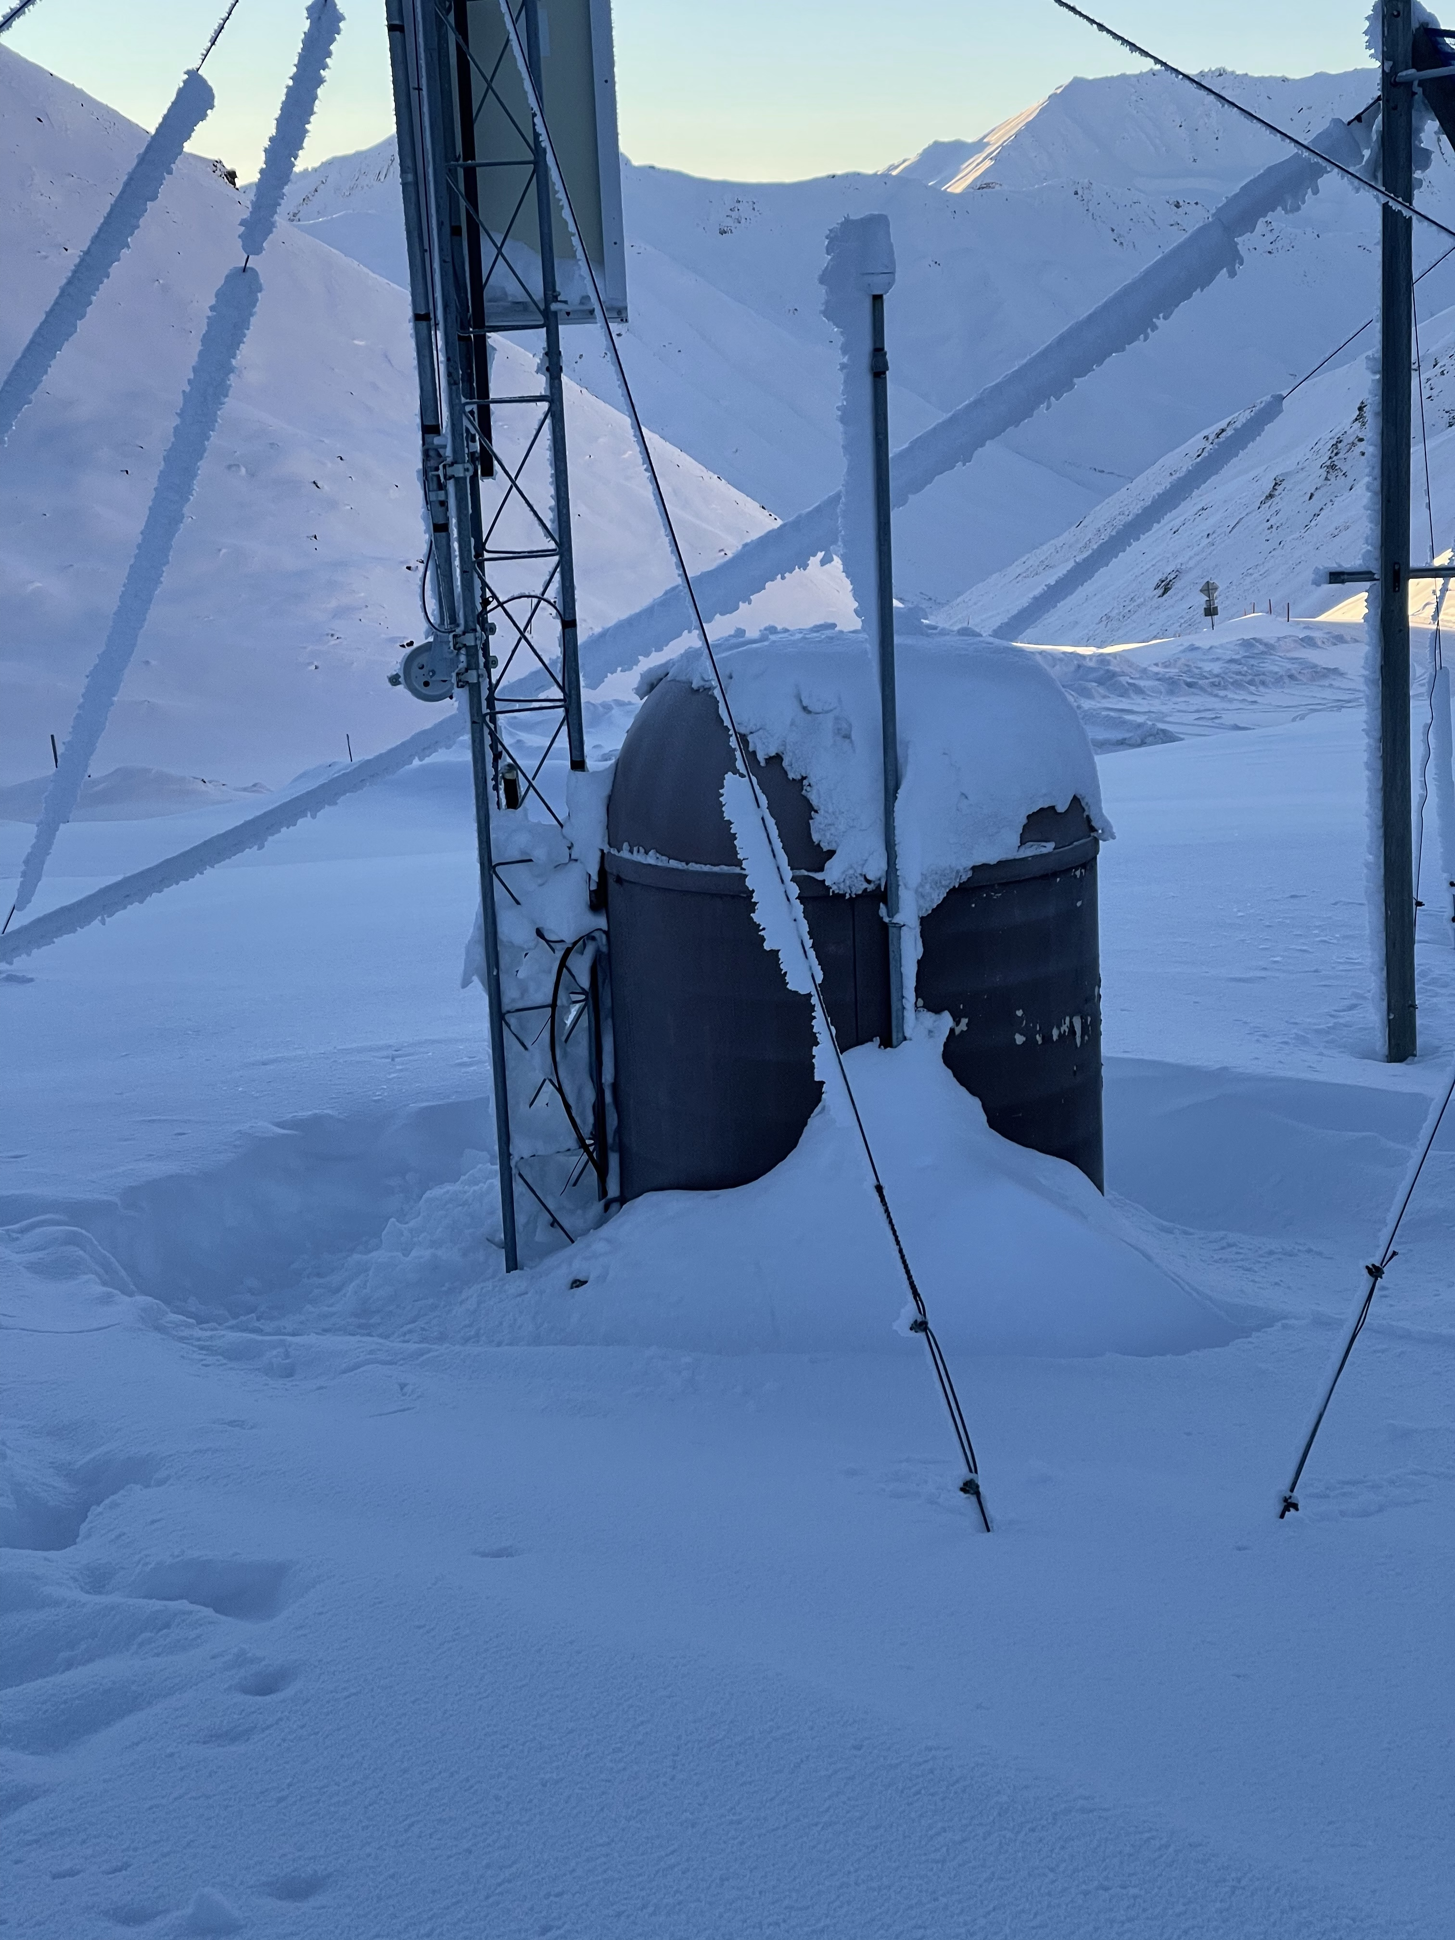
View Towards
AAW01

Slide 13
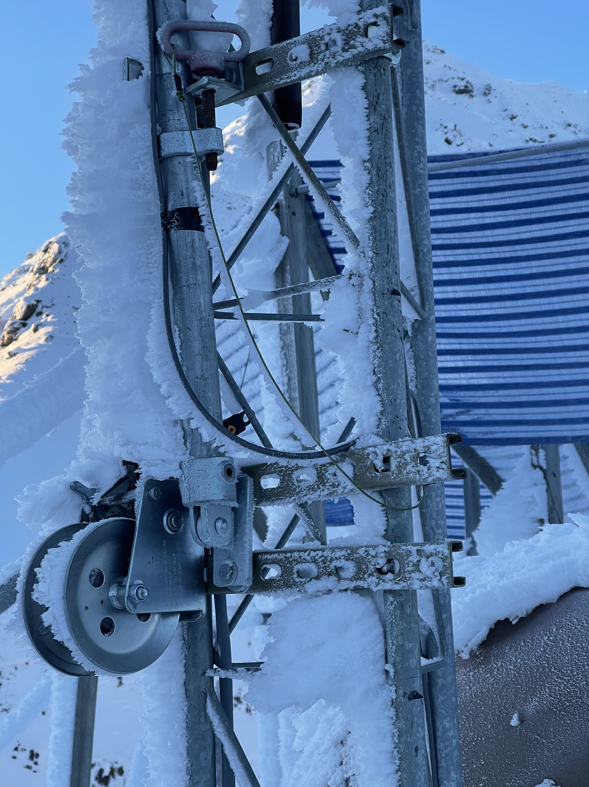
Tilt Down
Anemometer Tower

Slide 14
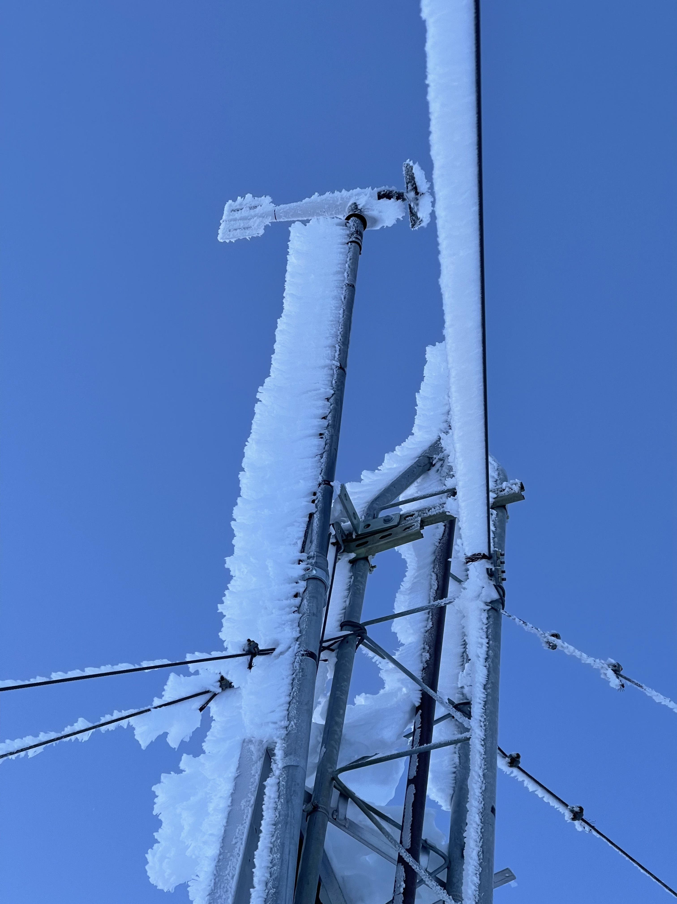
Tilt Down
Anemometer Tower

Slide 15
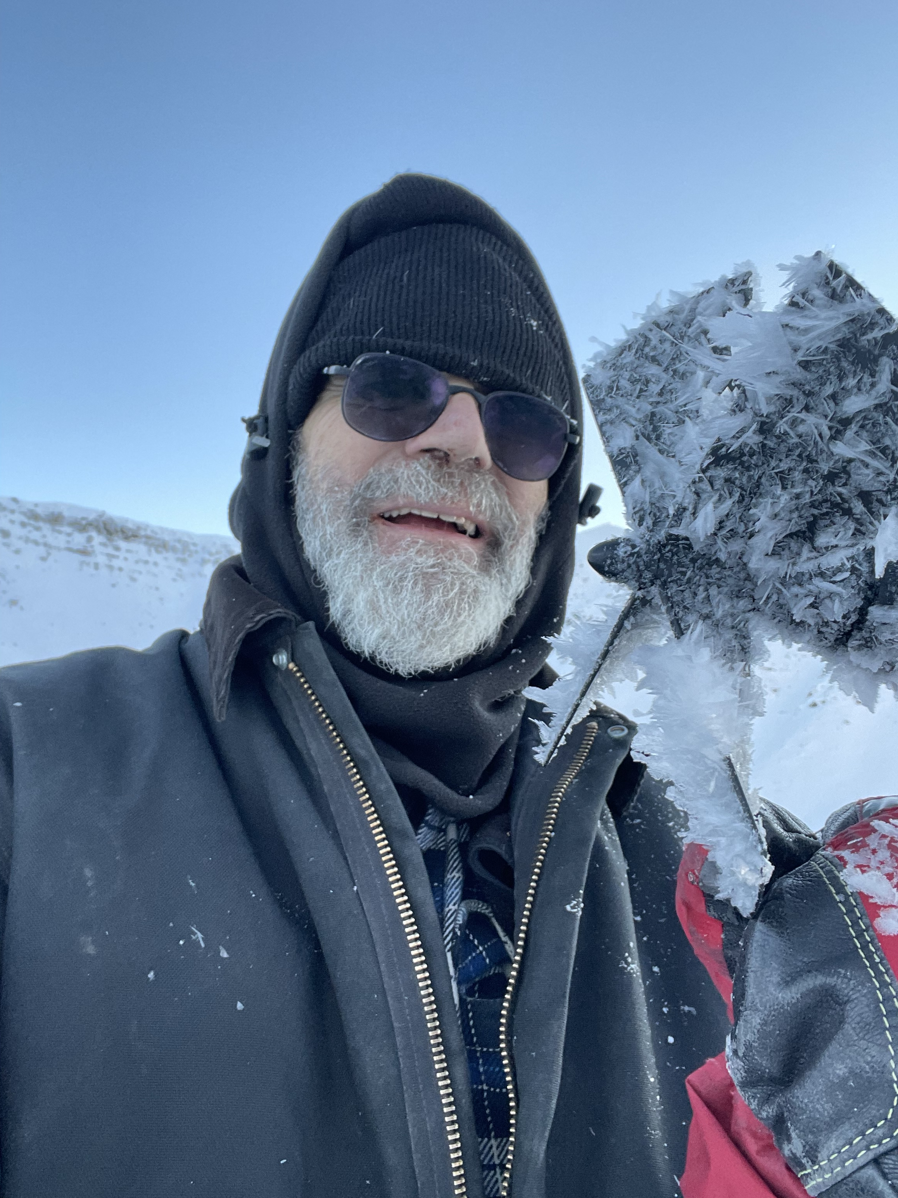
Tilt Down
Anemometer Tower

Slide 16
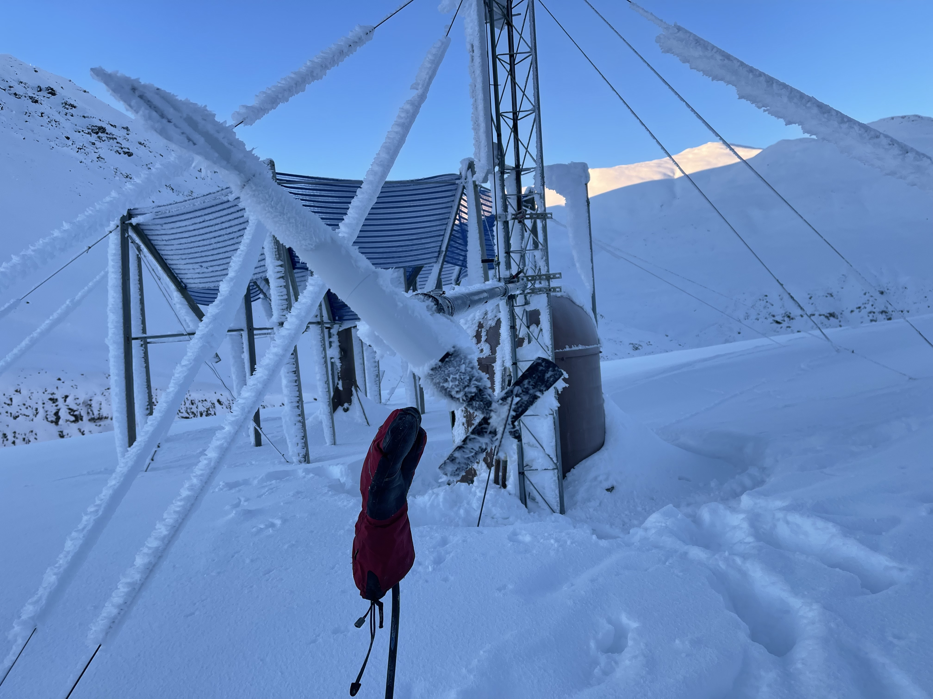
Tilt Down
Anemometer Tower

Slide 17
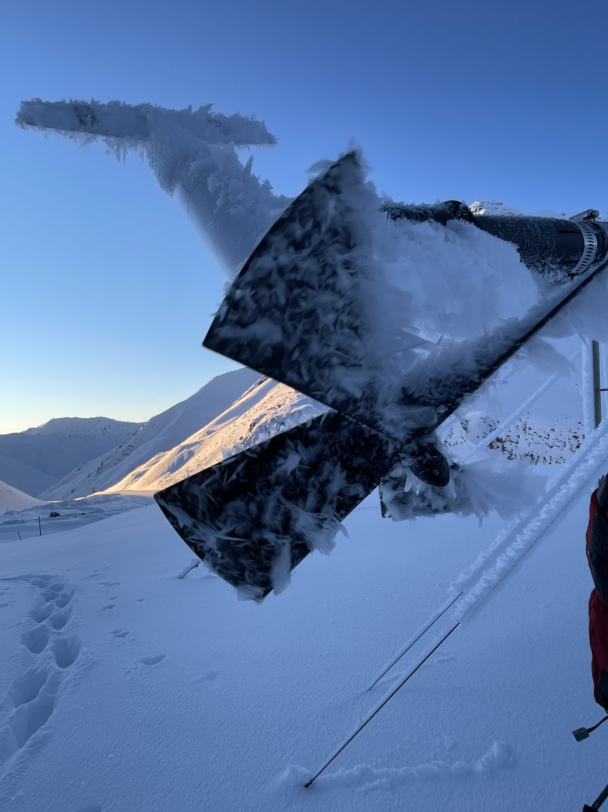
Tilt Down
Anemometer Tower

Slide 18
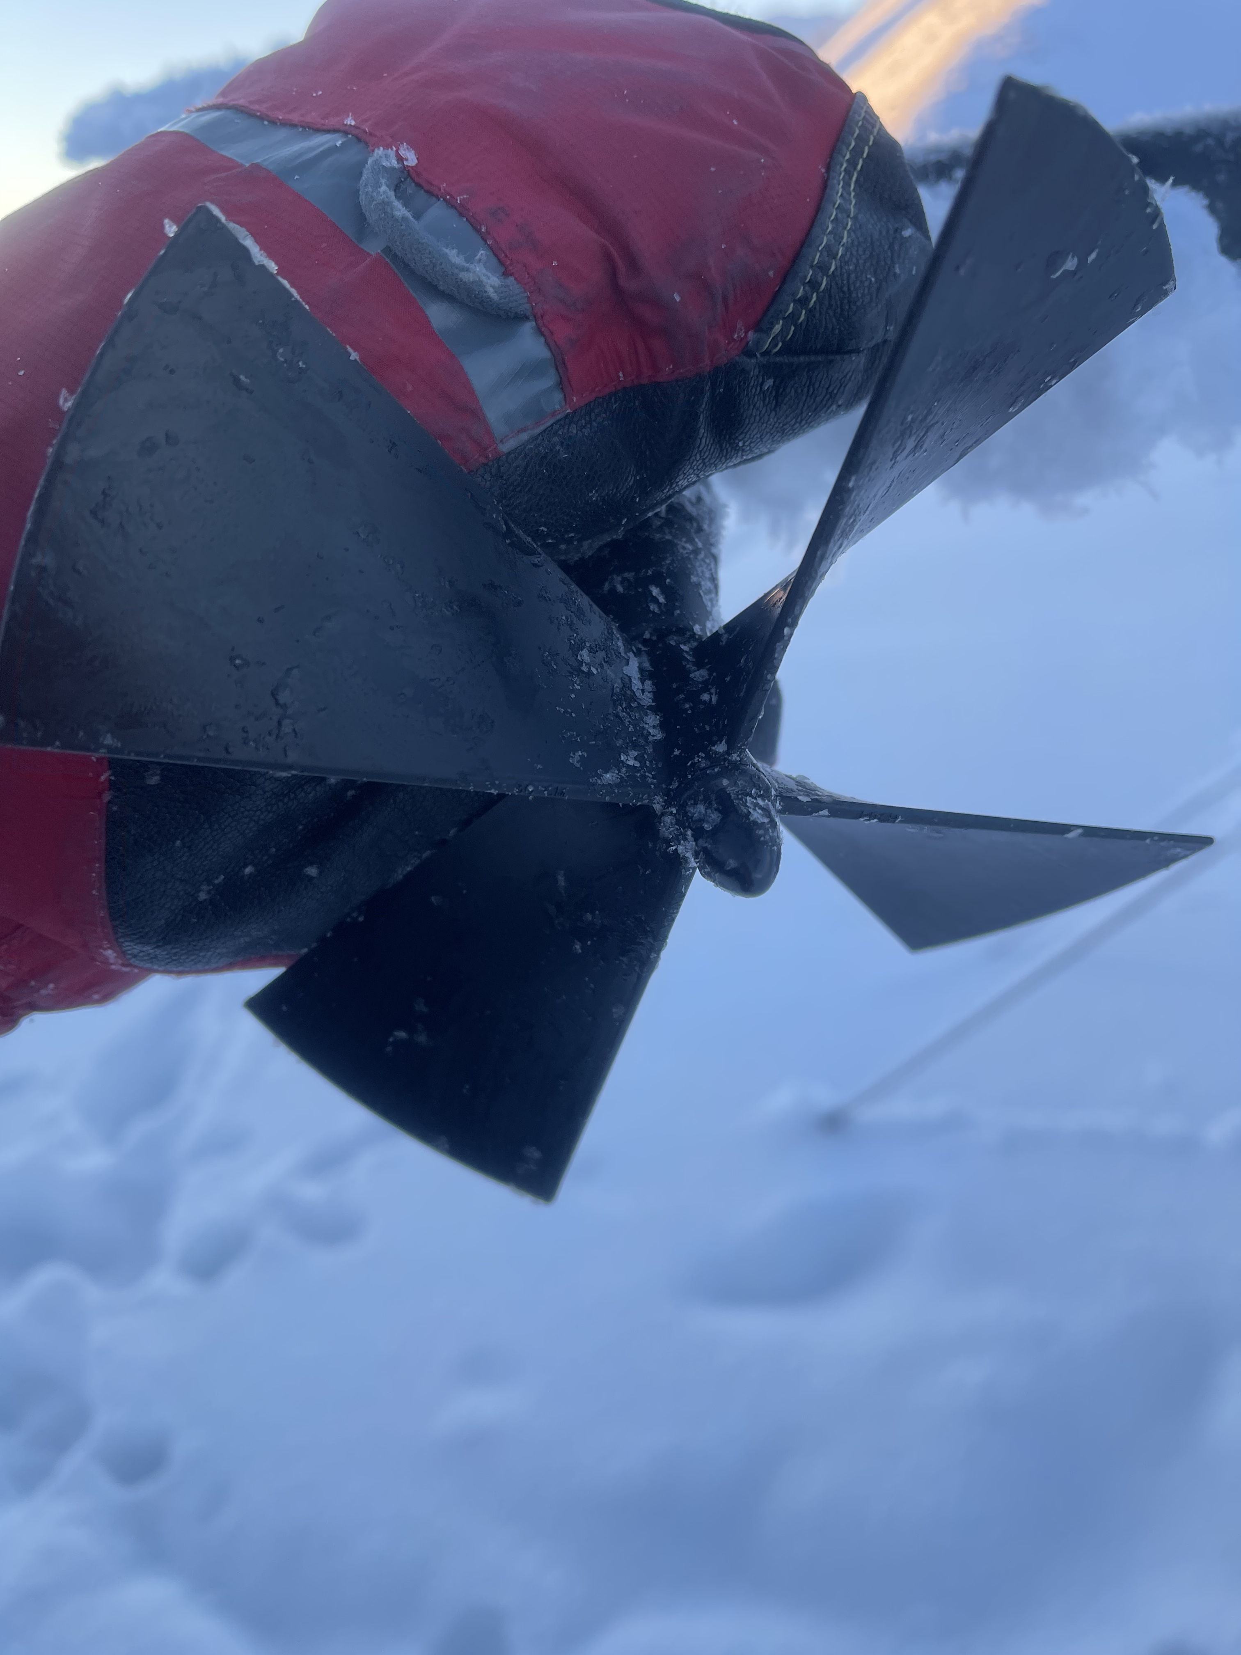
Tilt Down
Anemometer Tower

Slide 19
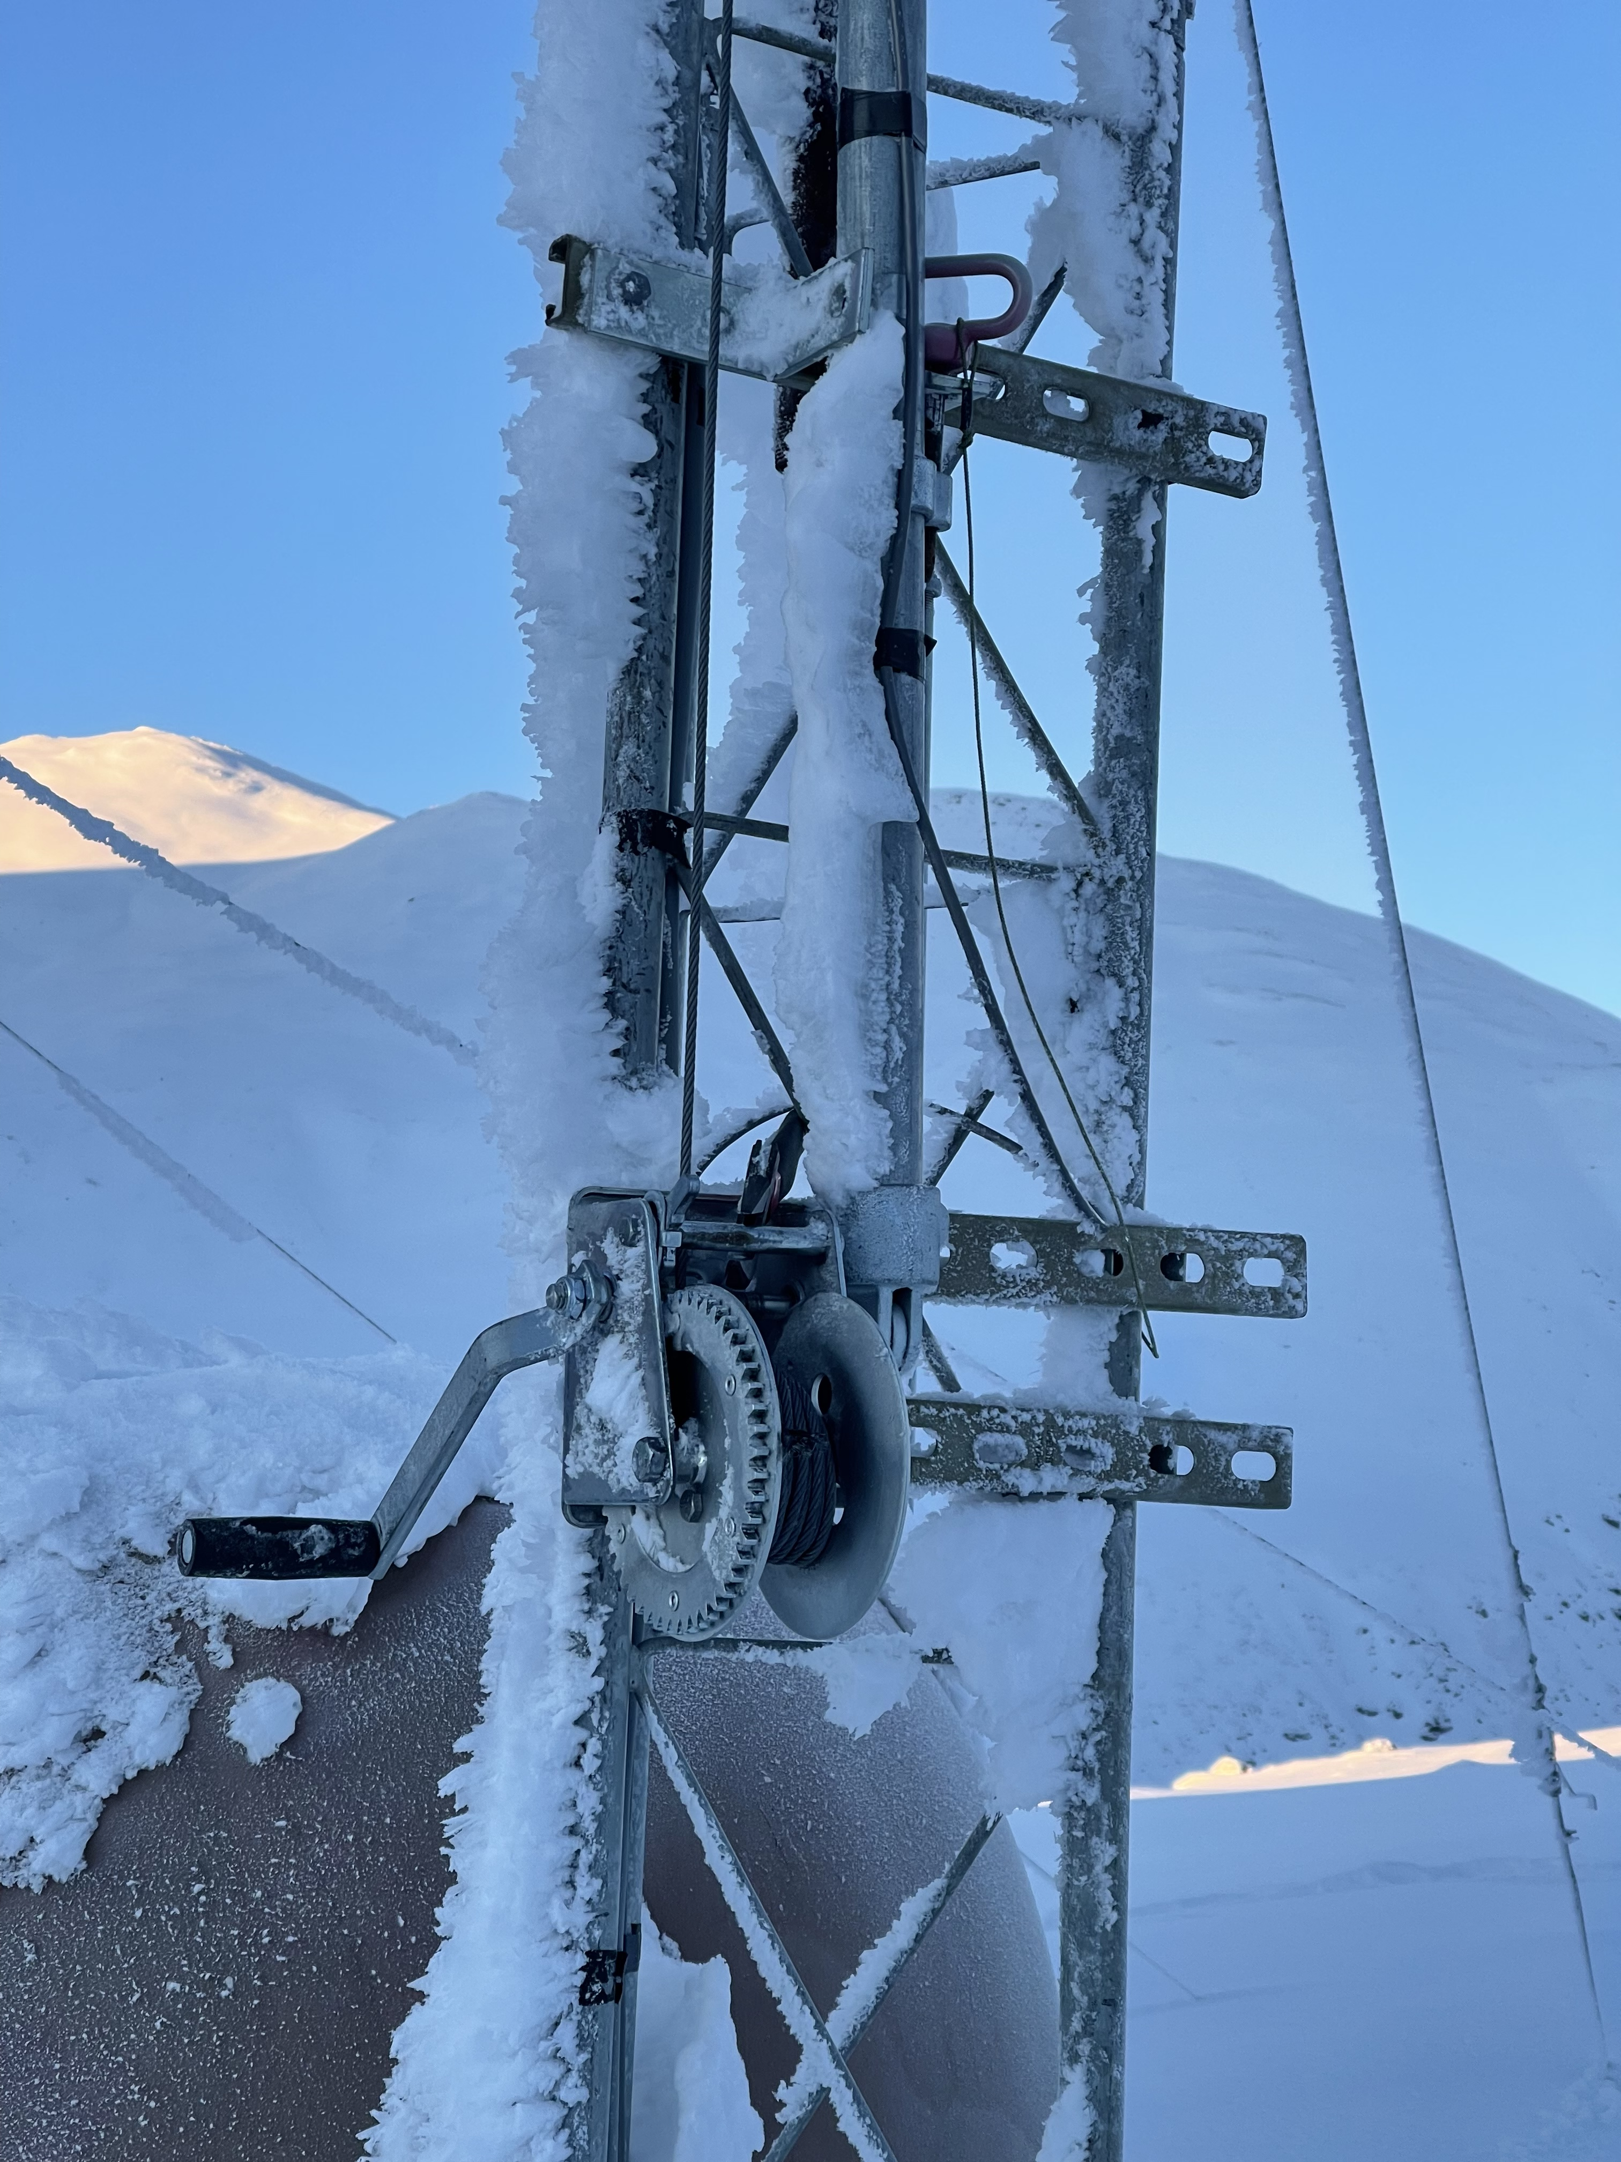
Tilt Down
Anemometer Tower

Slide 20
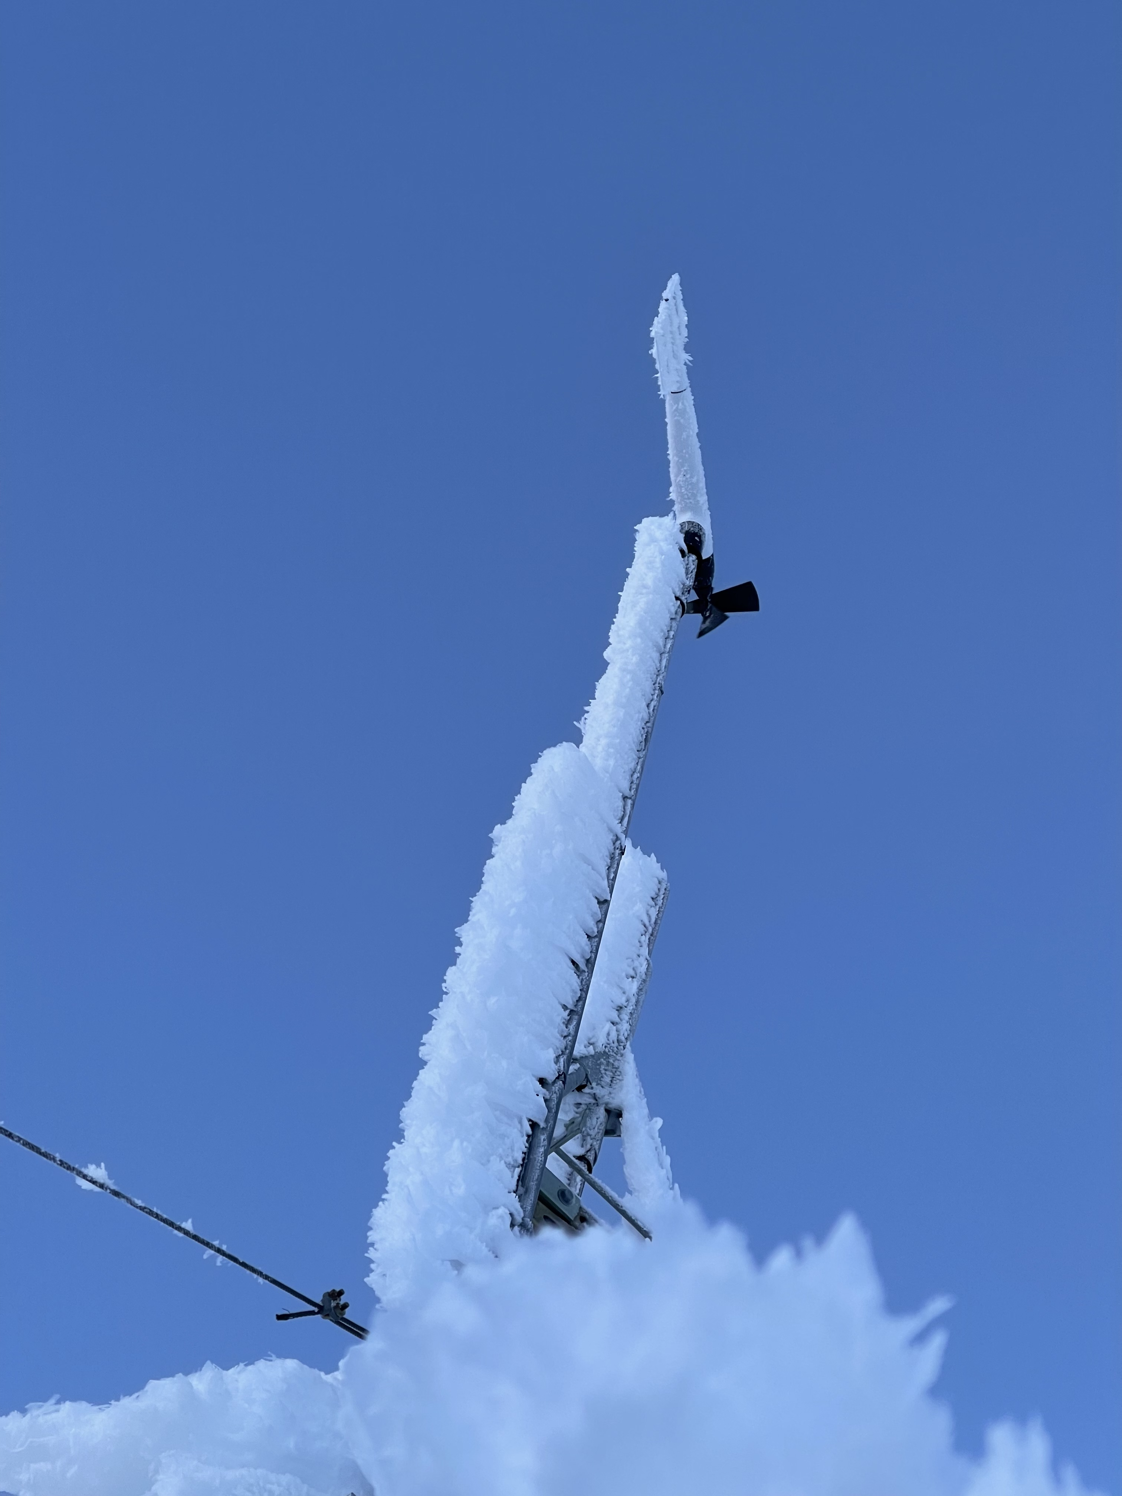
Tilt Down
Anemometer Tower

Slide 21
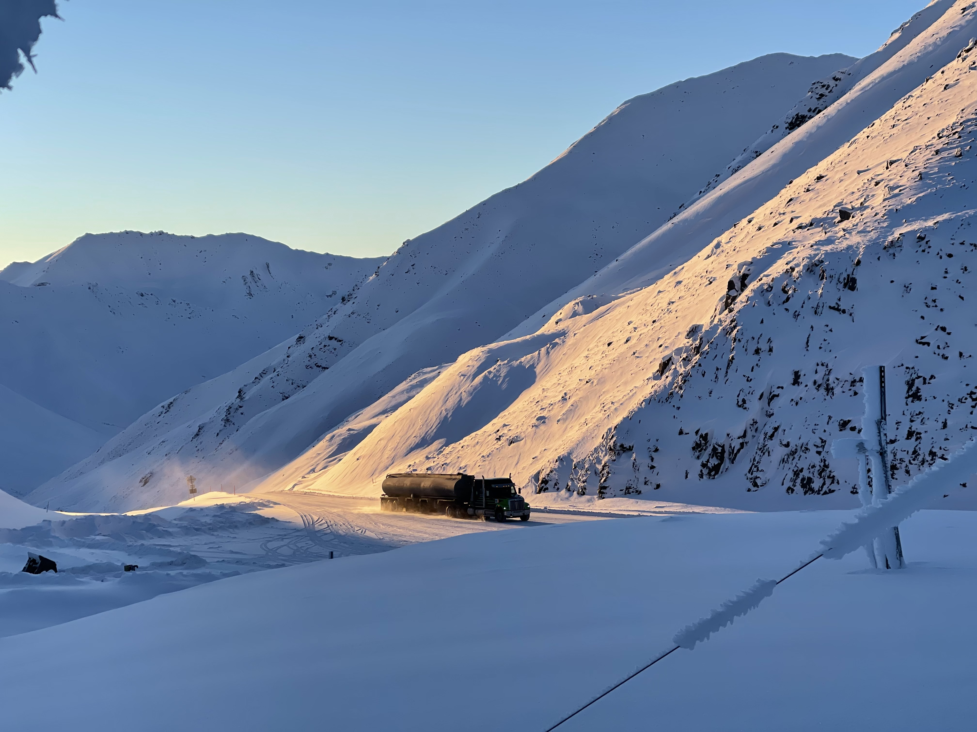
View Towards
AAW01

Slide 22
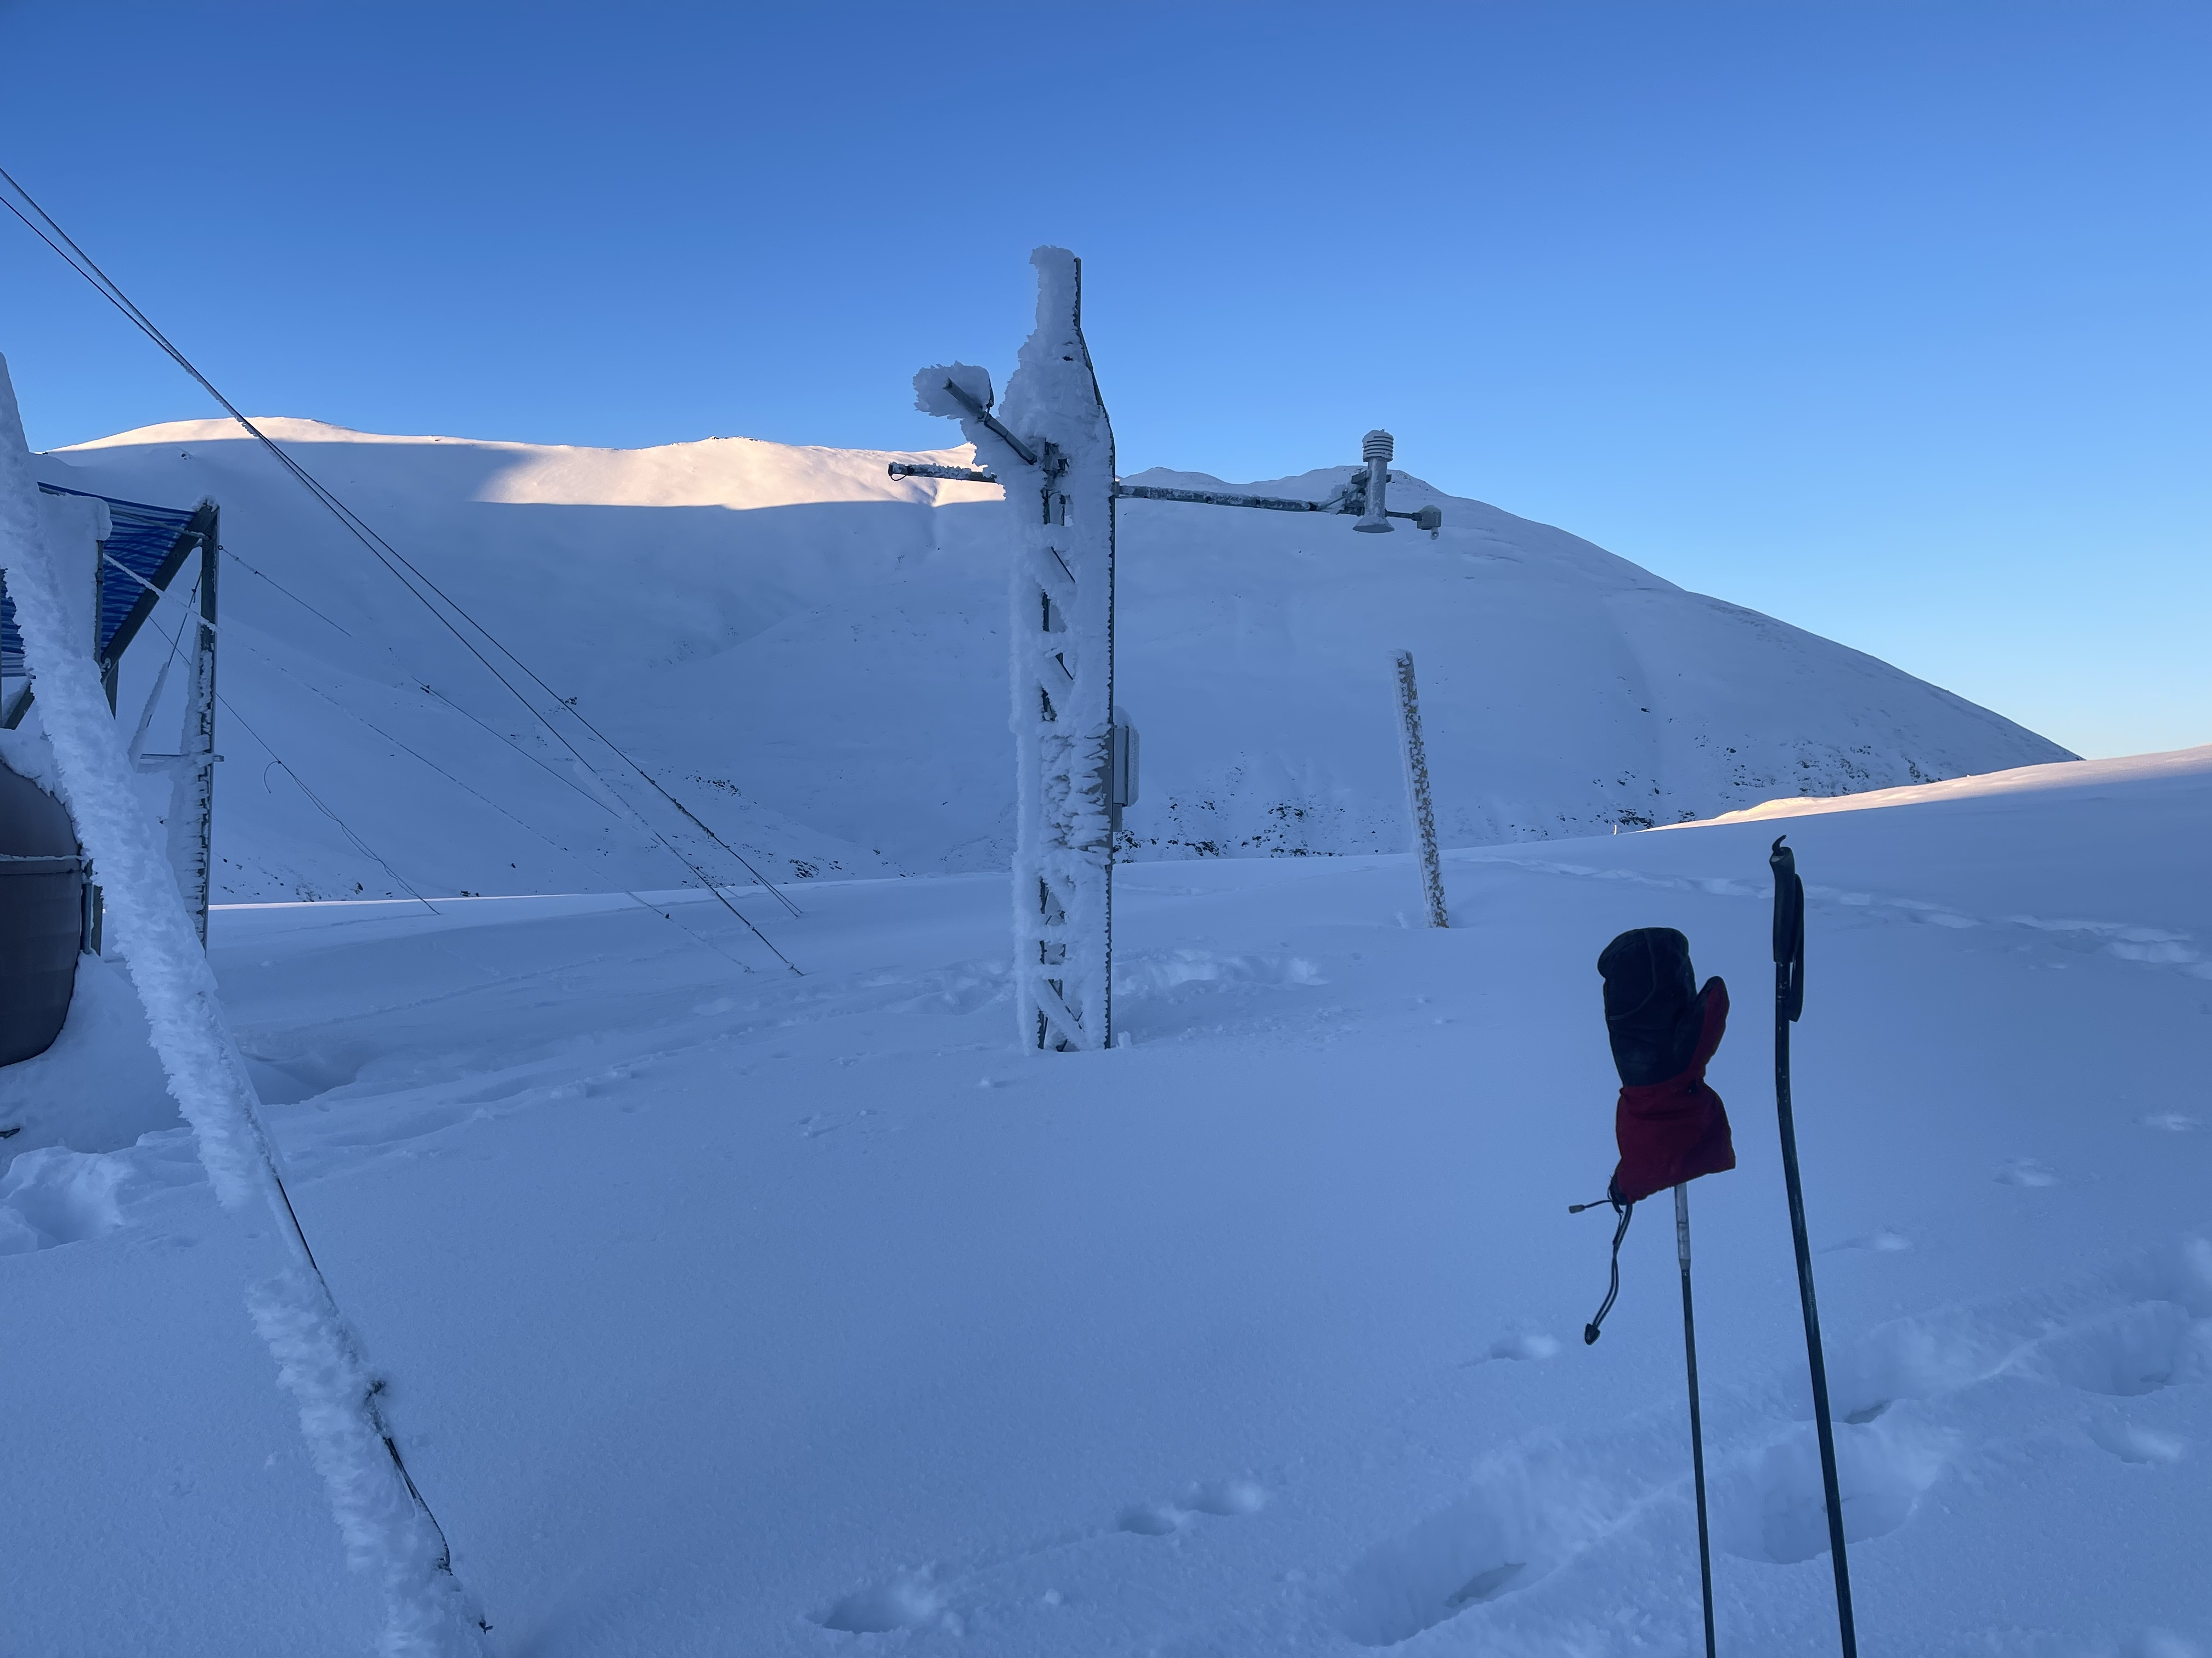
View Towards
AAW03

Slide 23
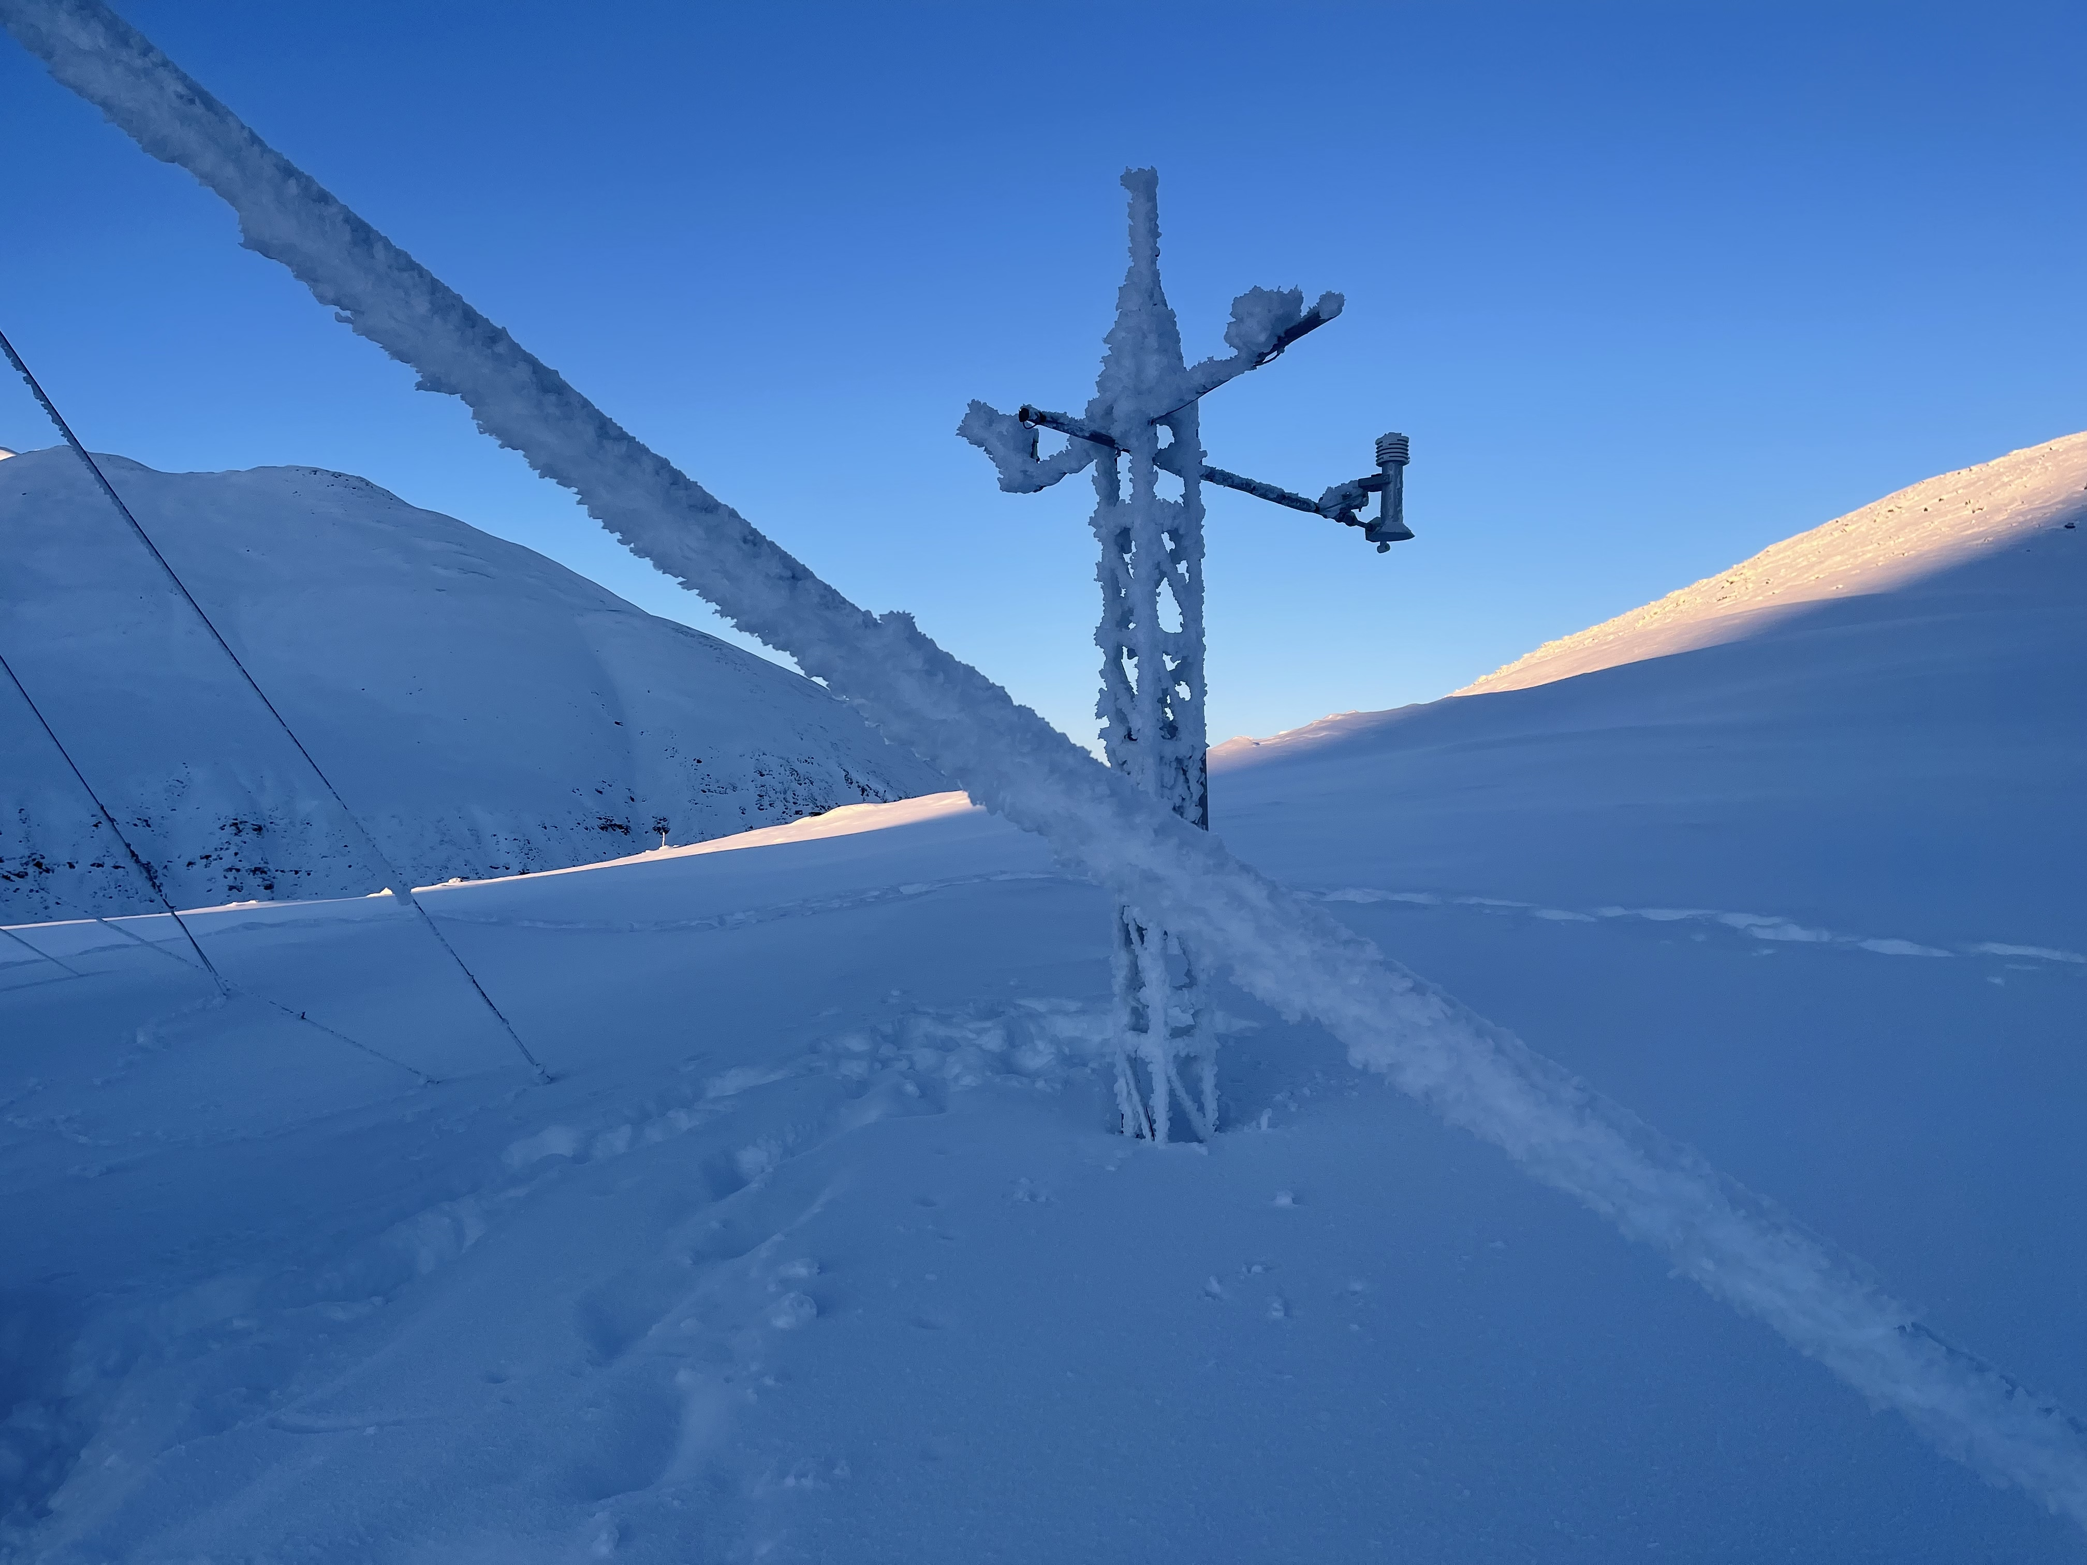
View Towards
AAW04

Slide 24
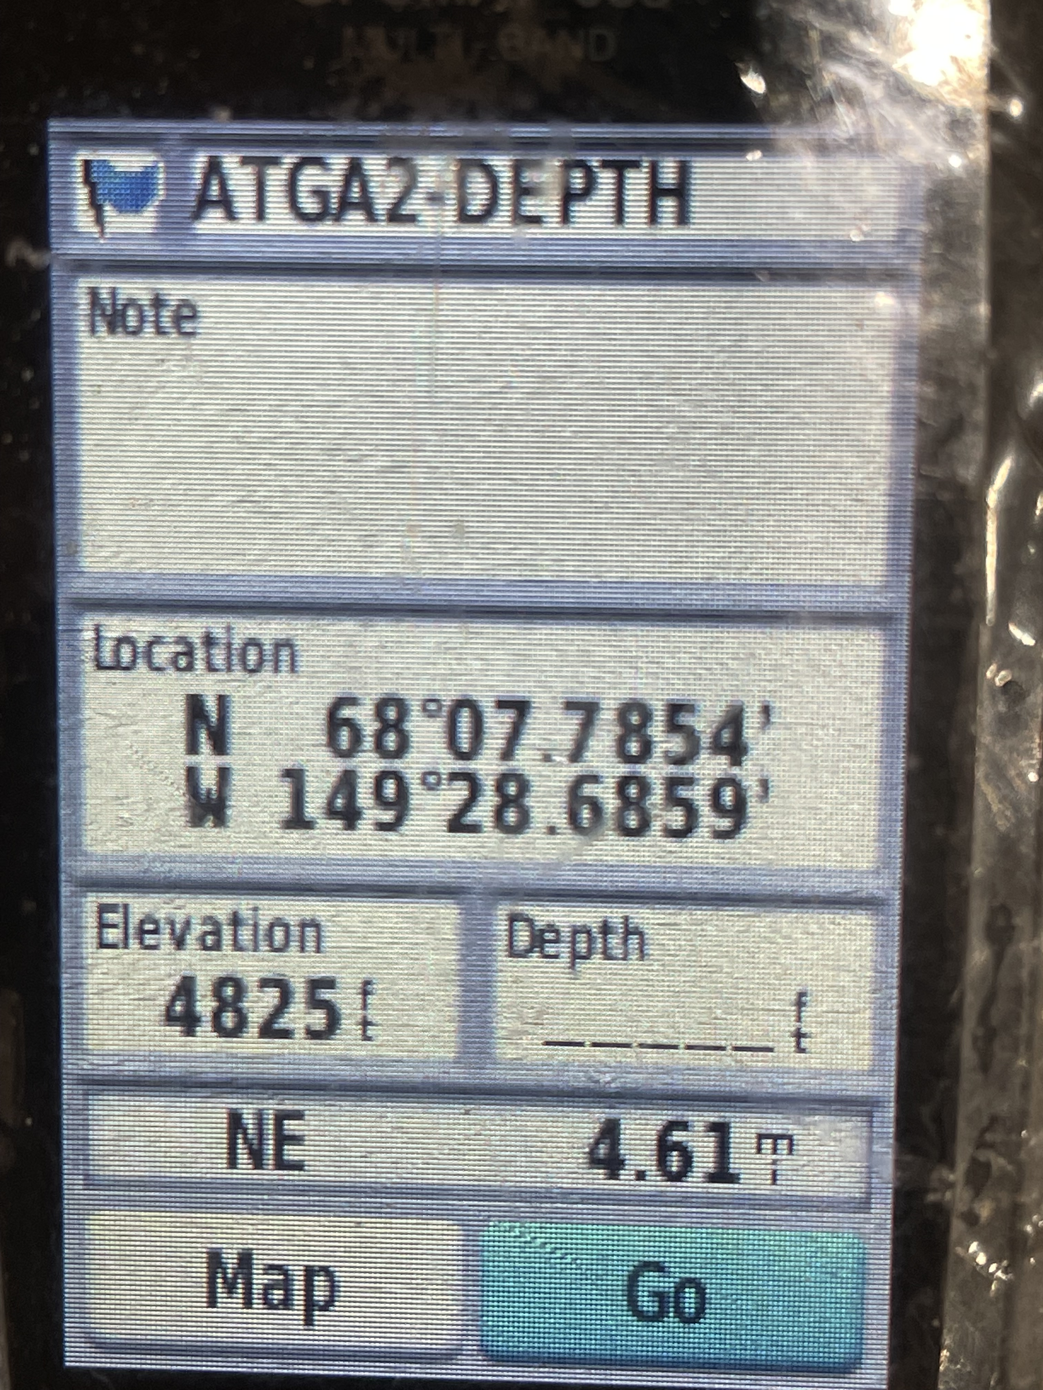
GPS at SNOTEL
Depth Tower

Slide 25
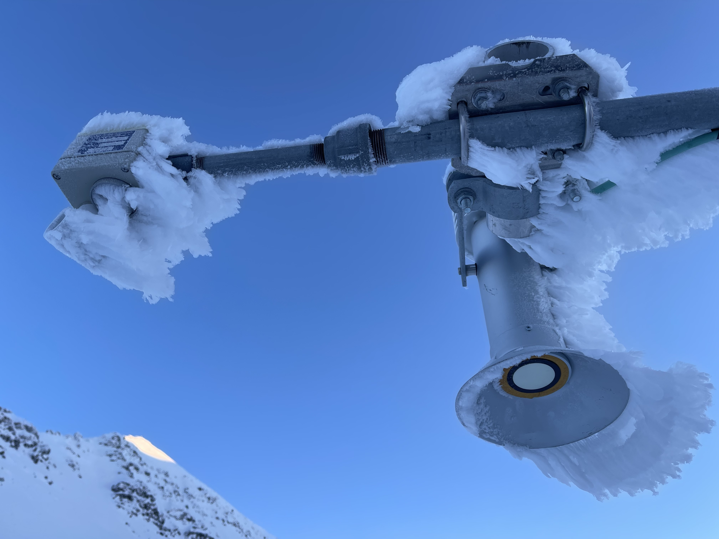
Snow Depth
Old sensor on left
(severe riming downtime)
I have manually derimed it
Hundreds of times over
9 winters
New sensor on right
(Installed summer 2022)
Not 1 single hour of
Downtime due to riming
All winter !!!!!!
I NEVER derimed it

Slide 26
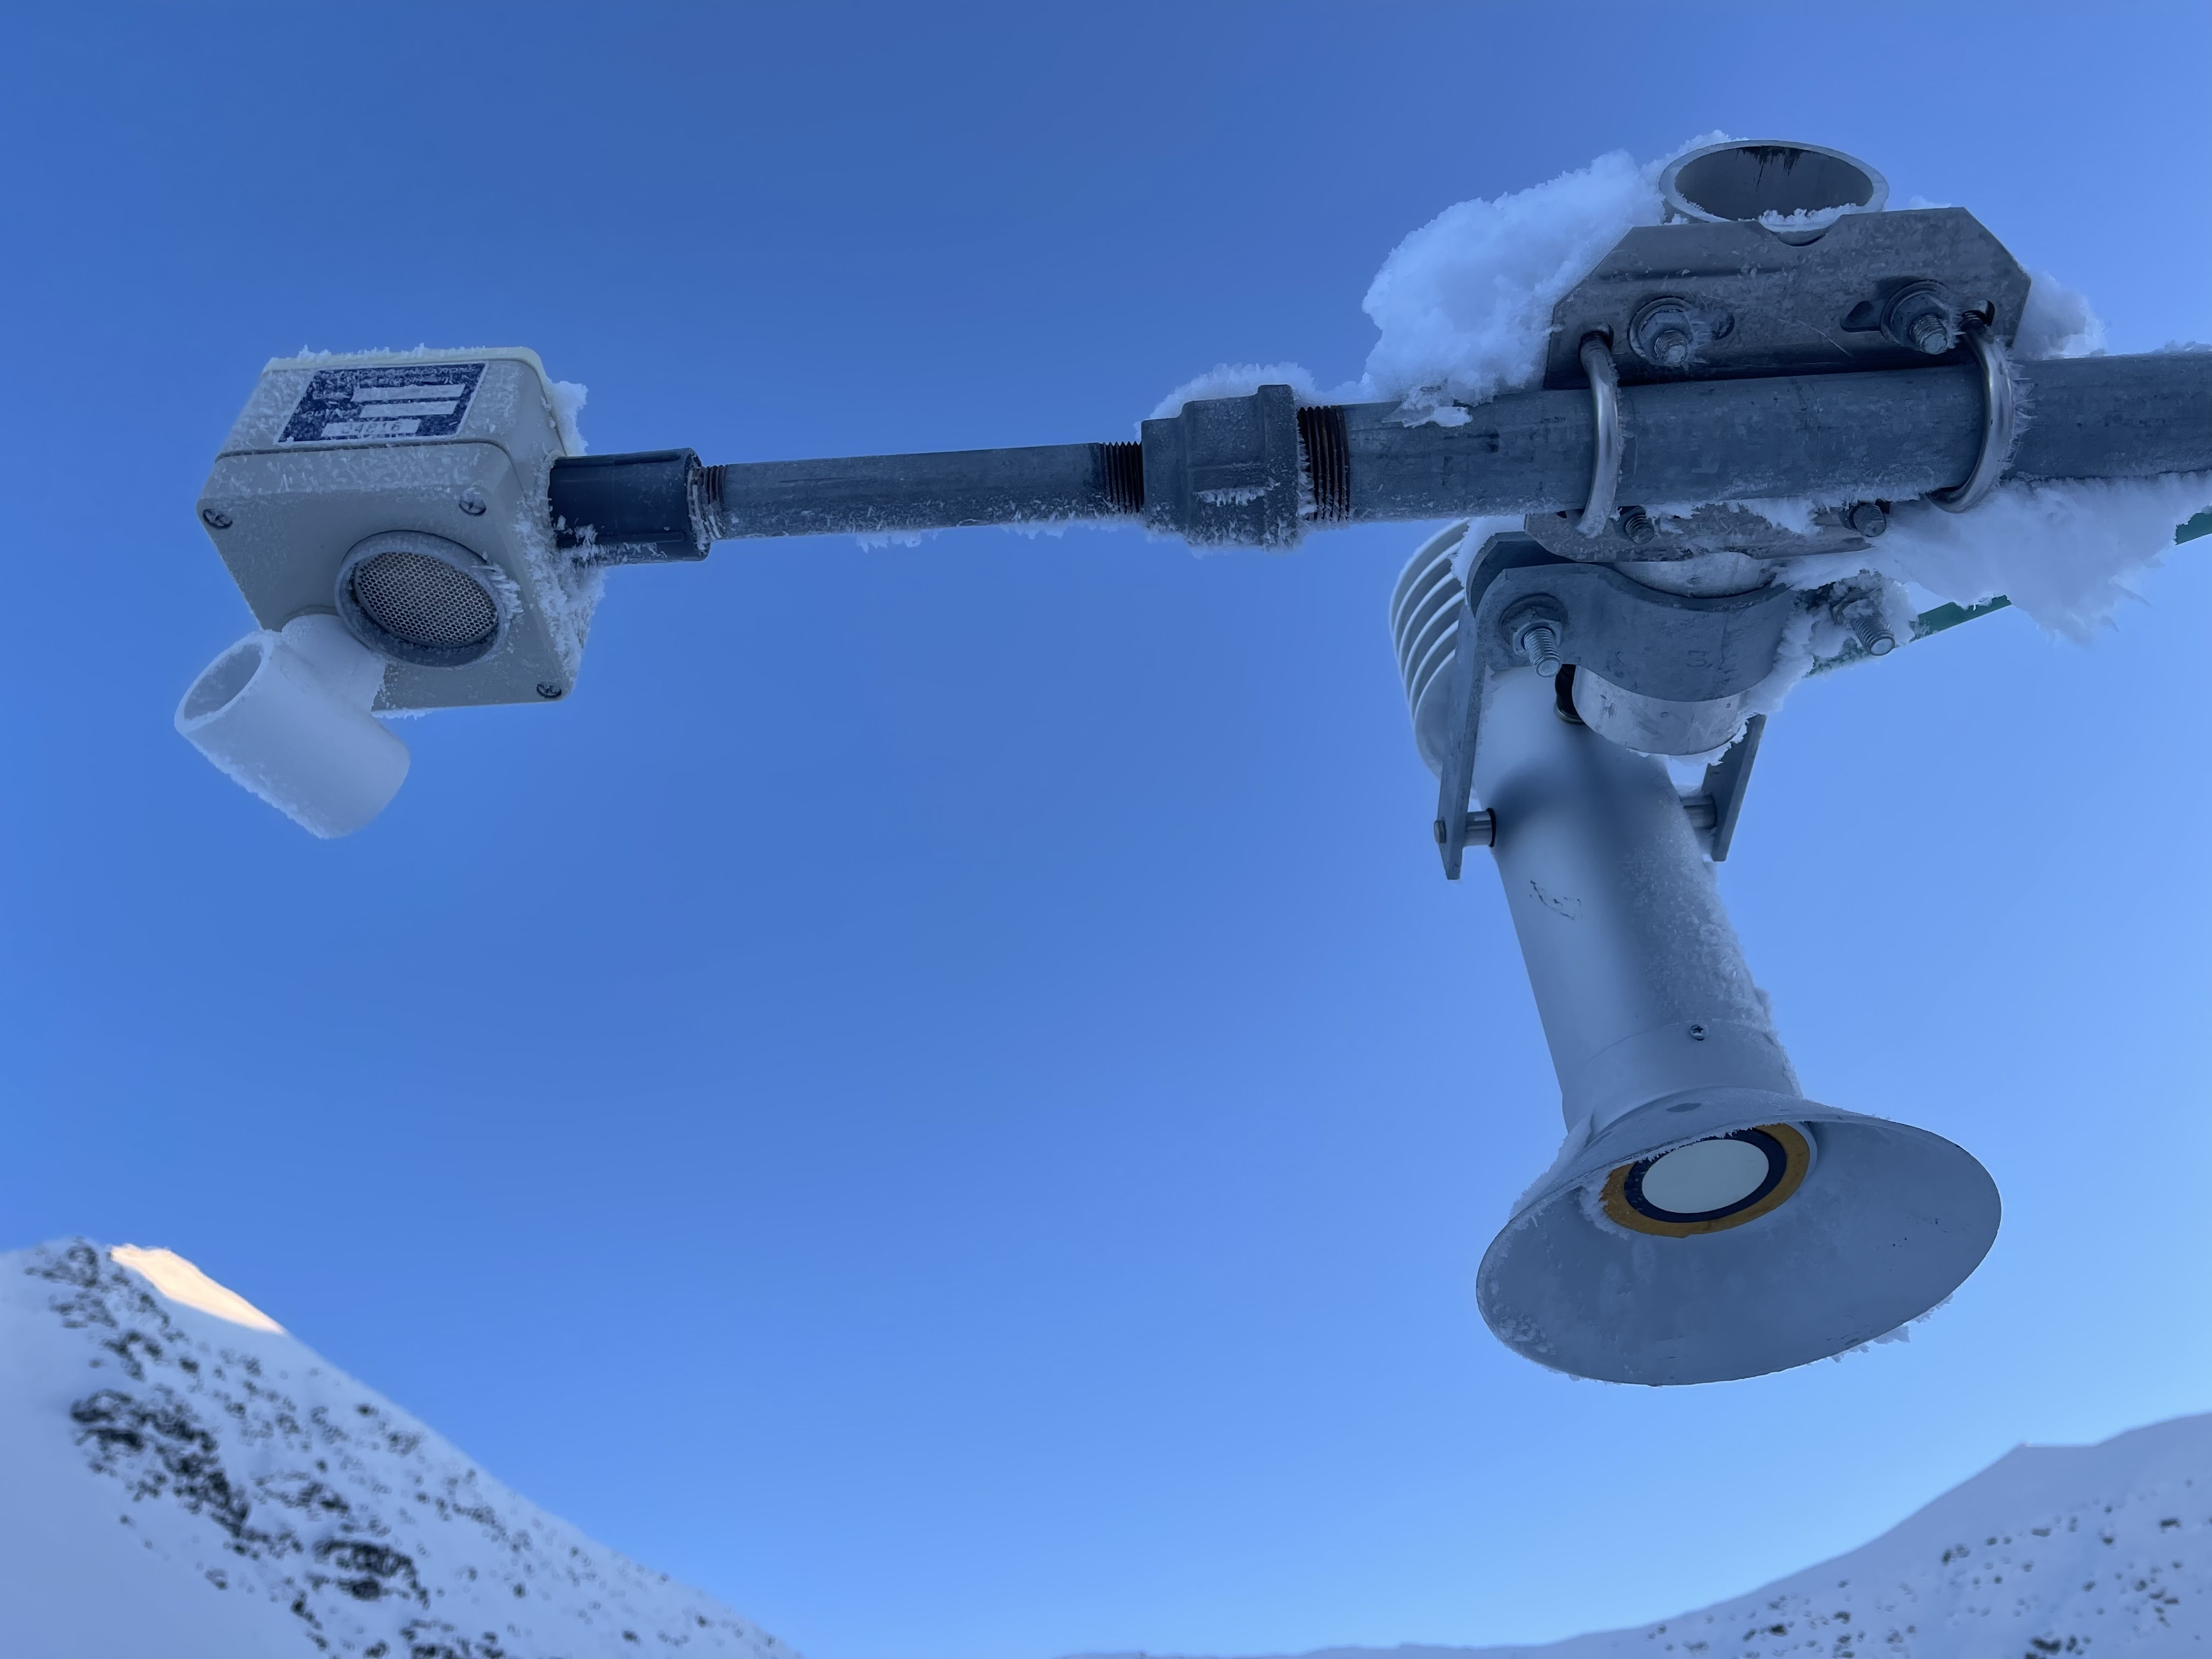
Except this day, because
I wanted to see
What it was !

Slide 27
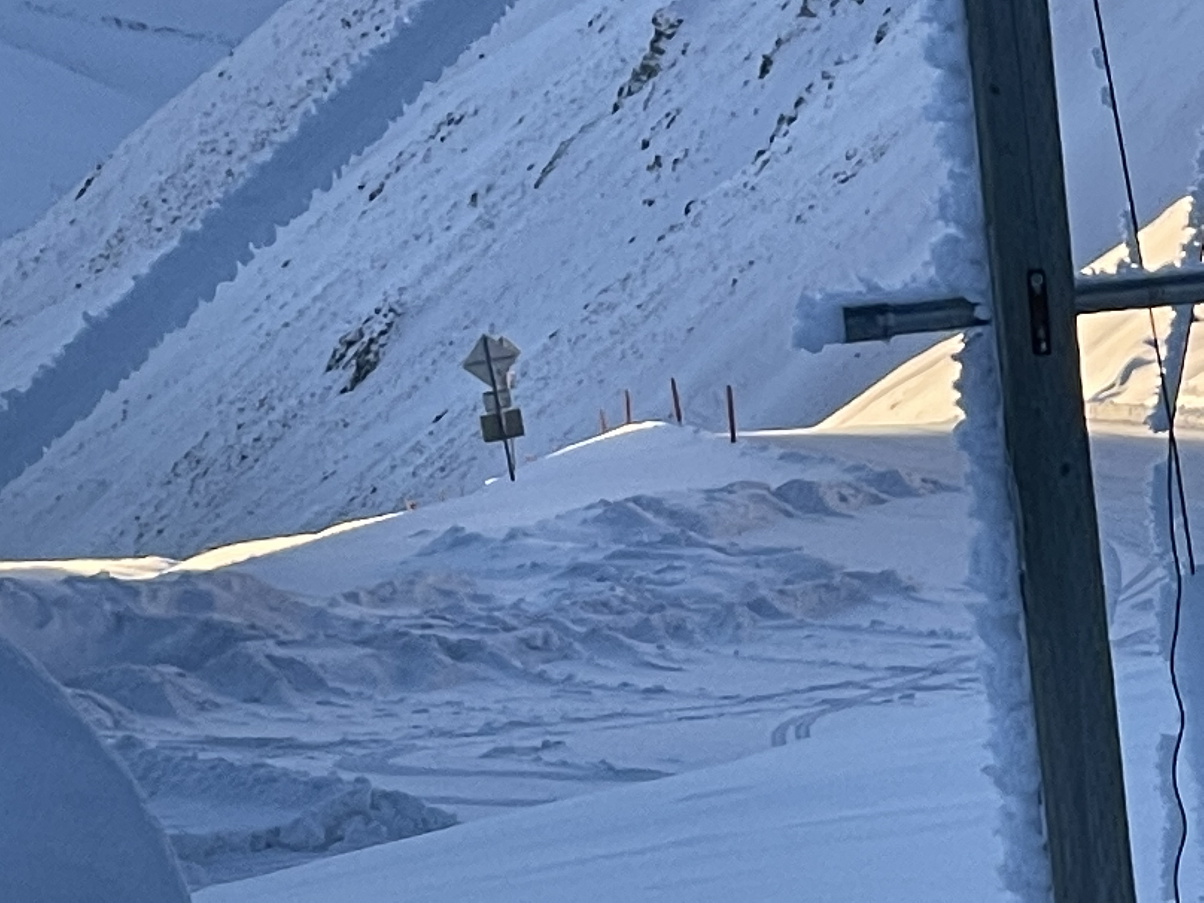
View Towards
AAW01

Slide 28
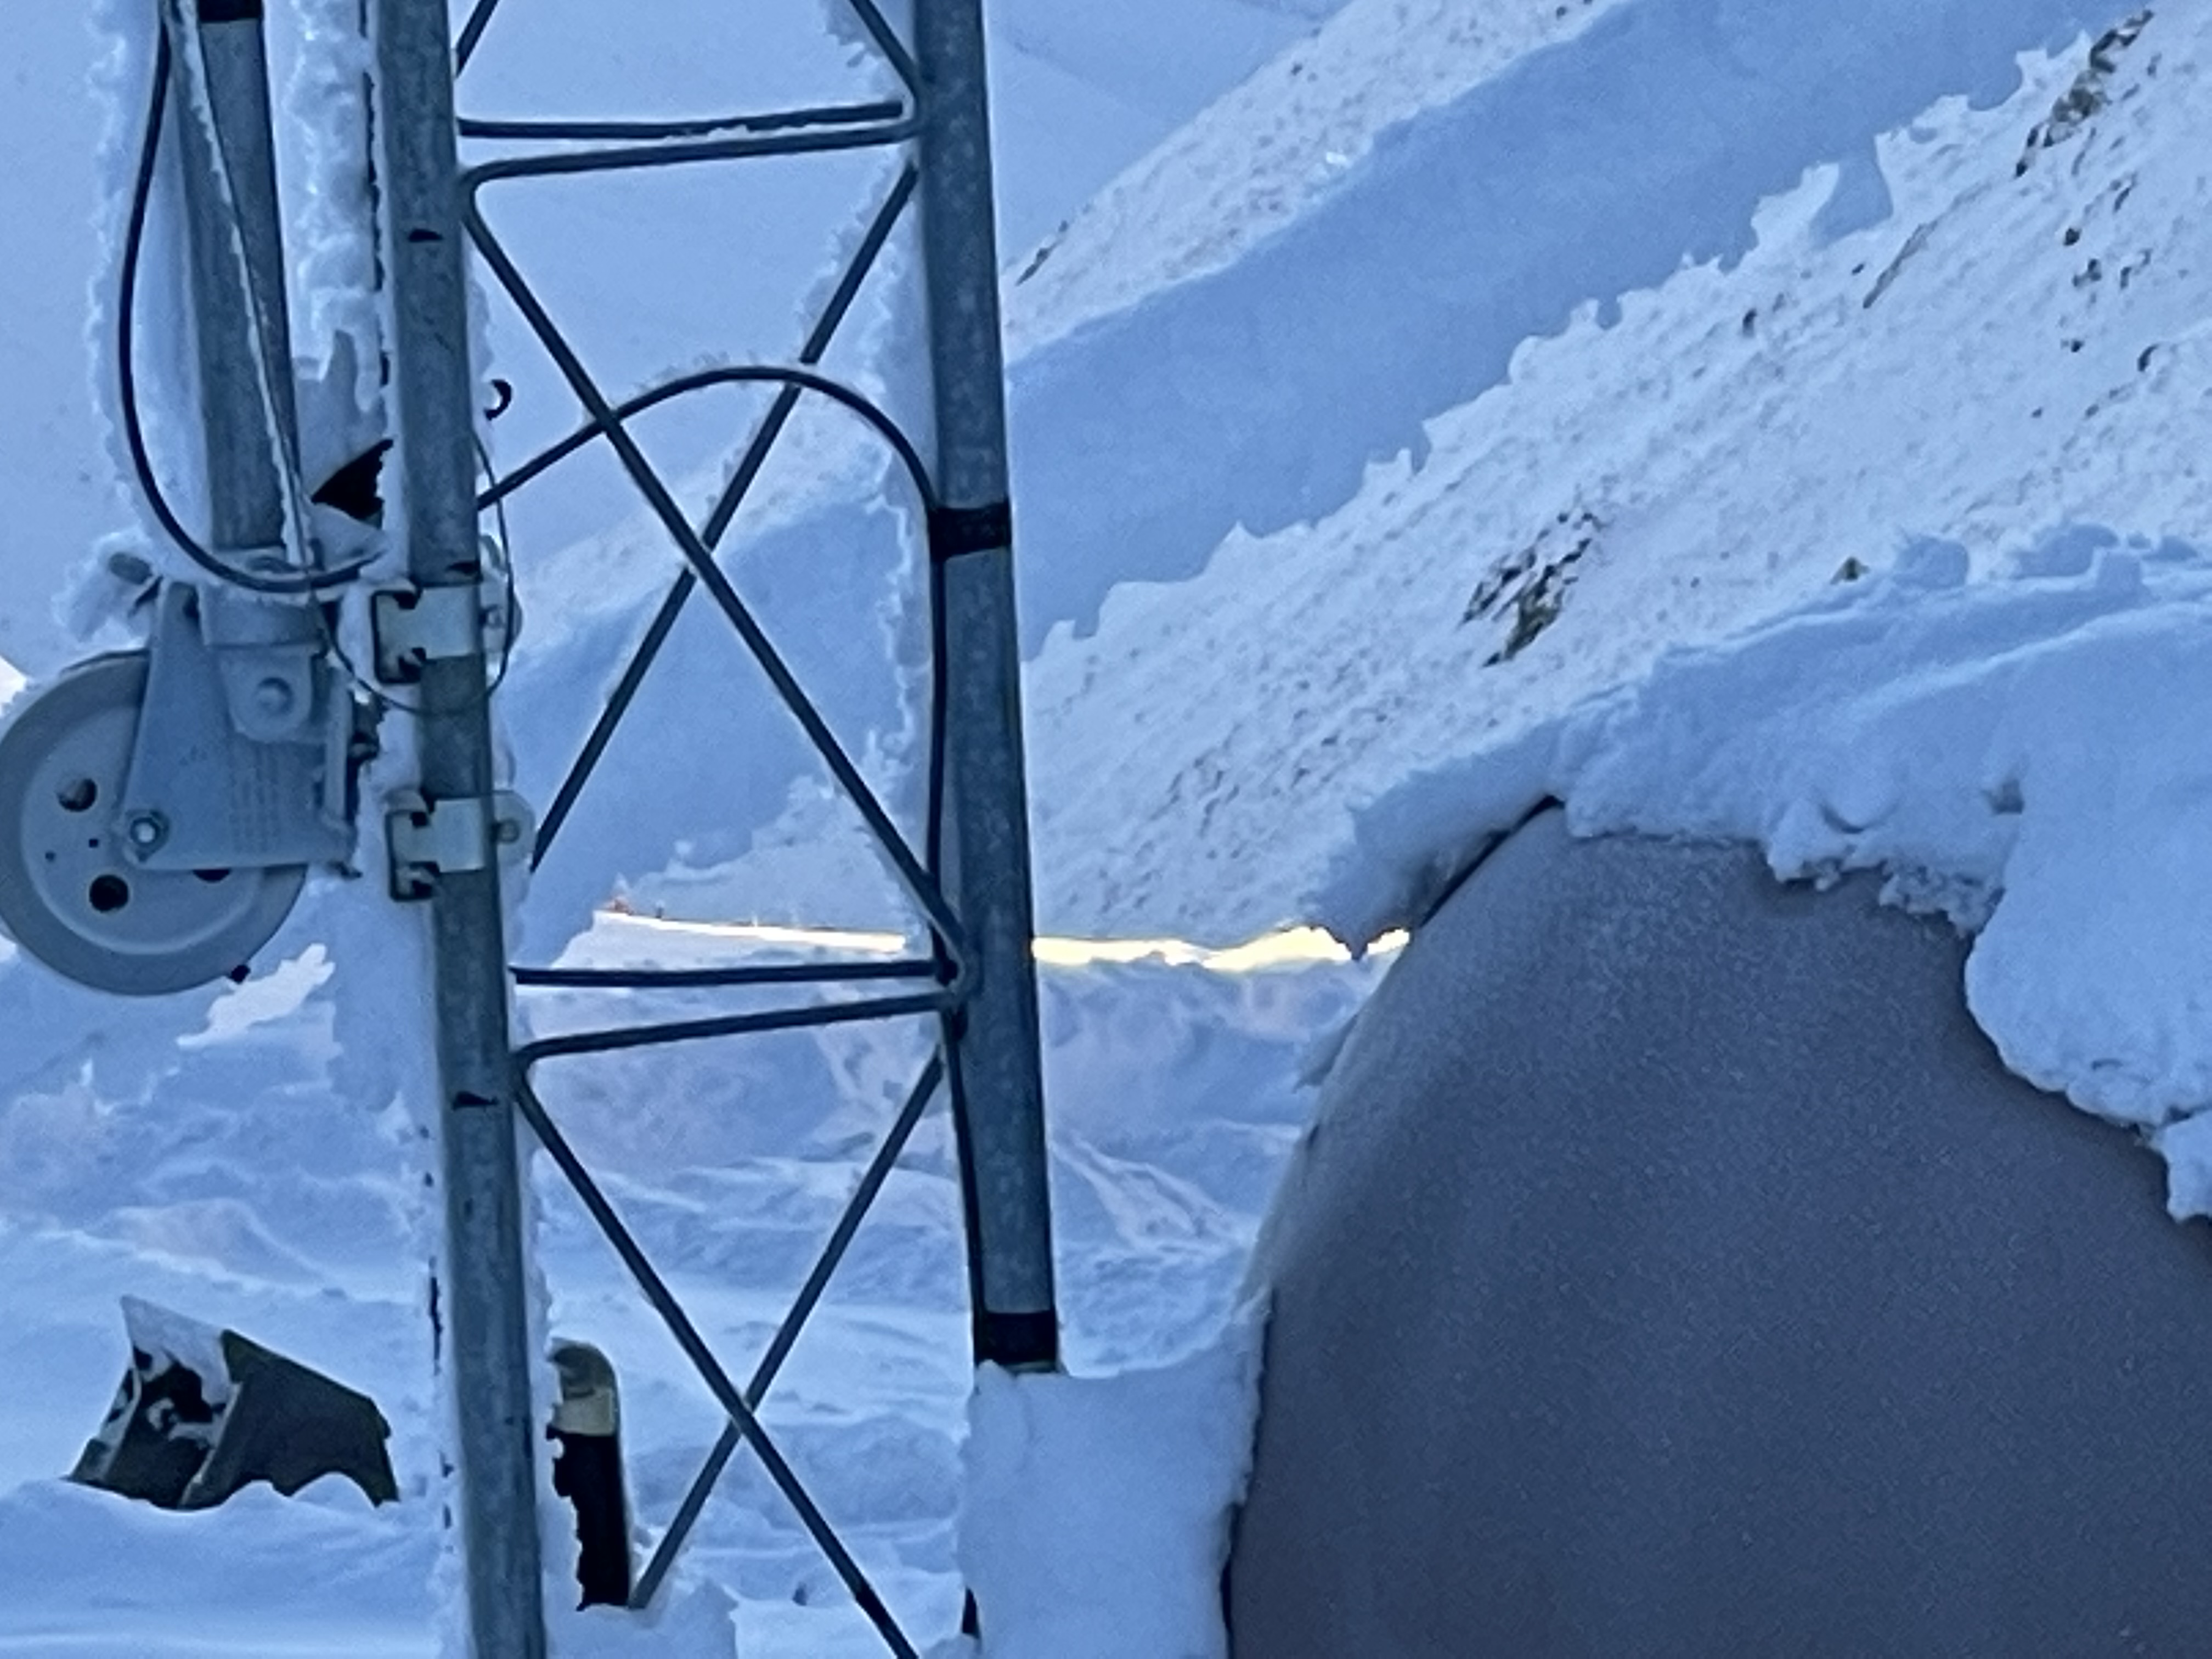

Slide 29
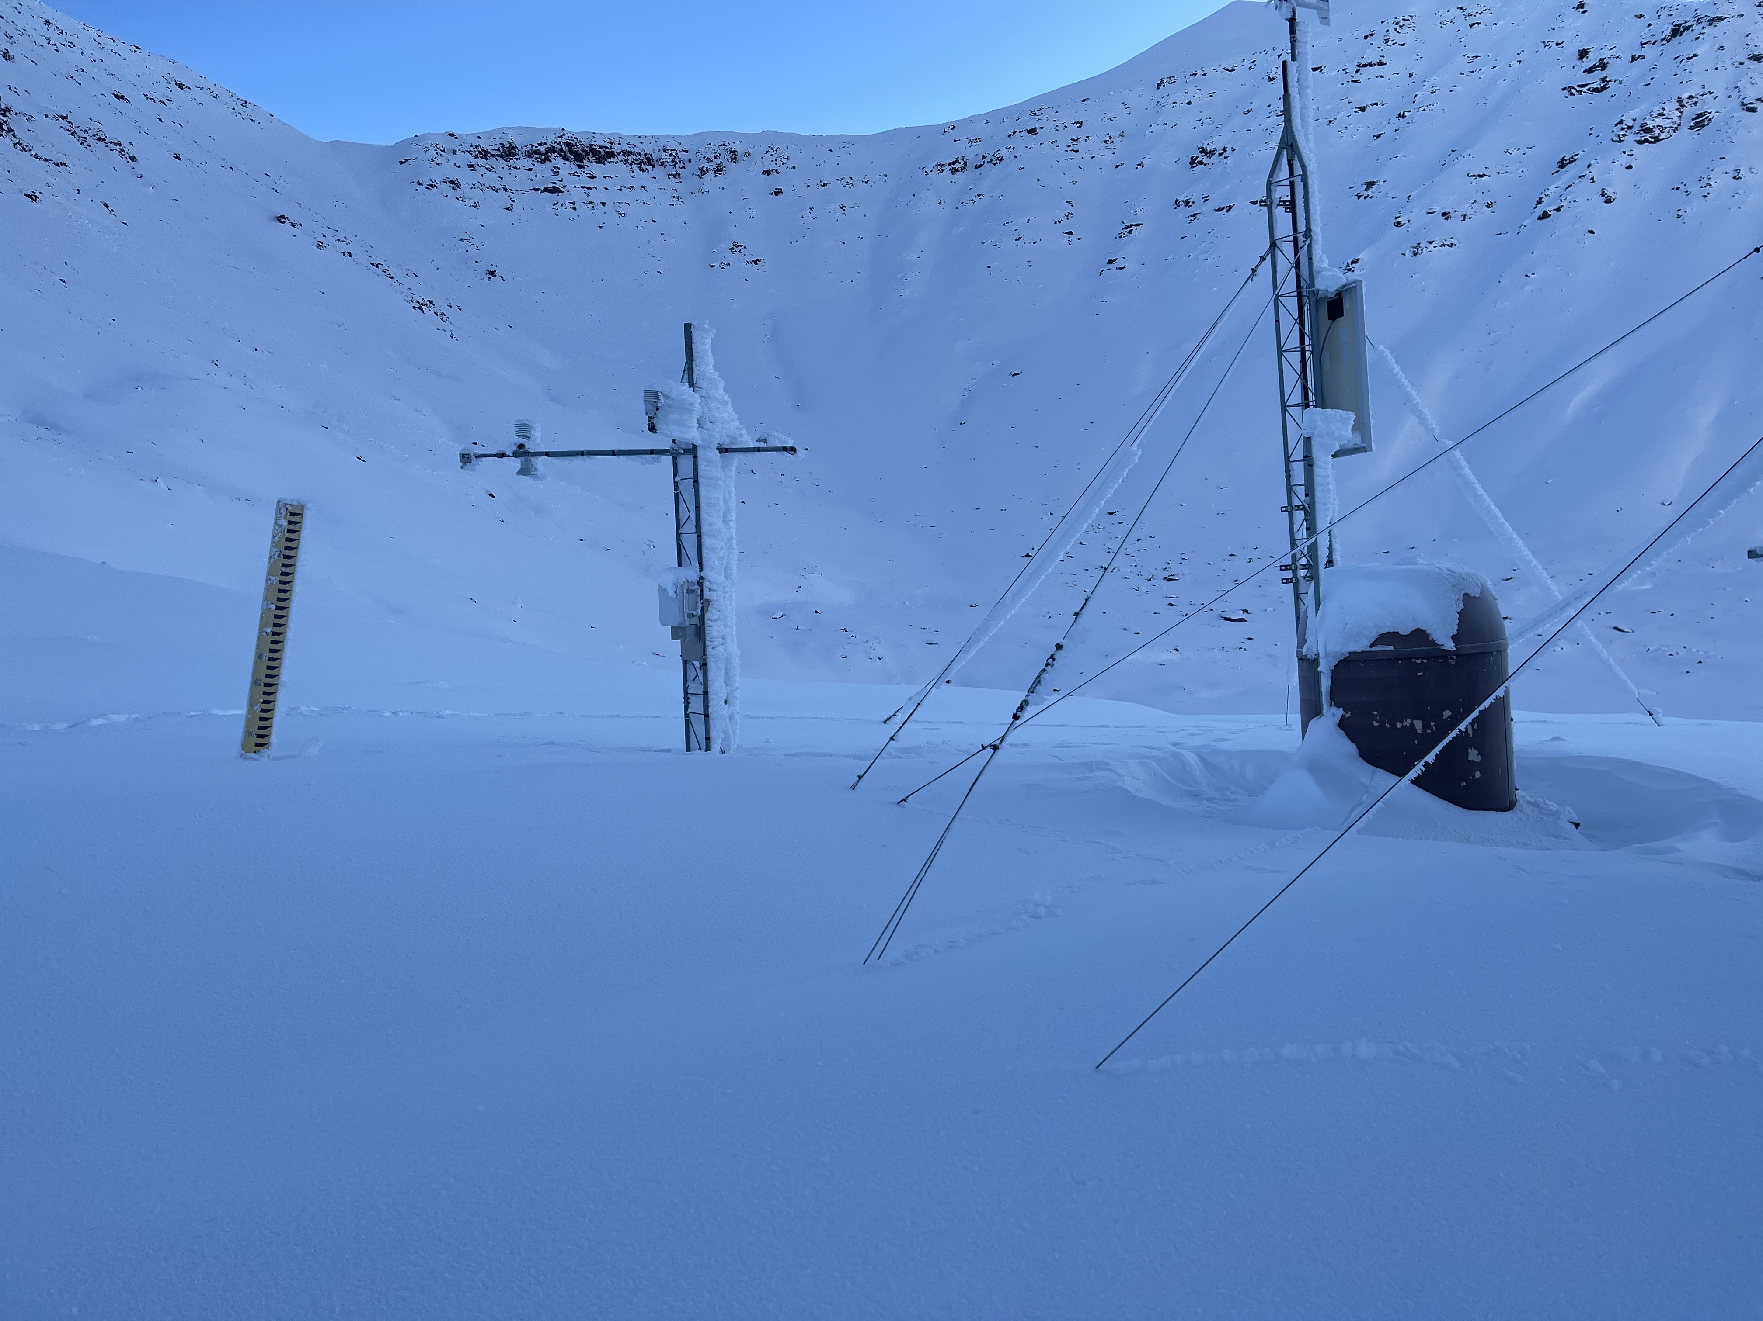

Slide 30
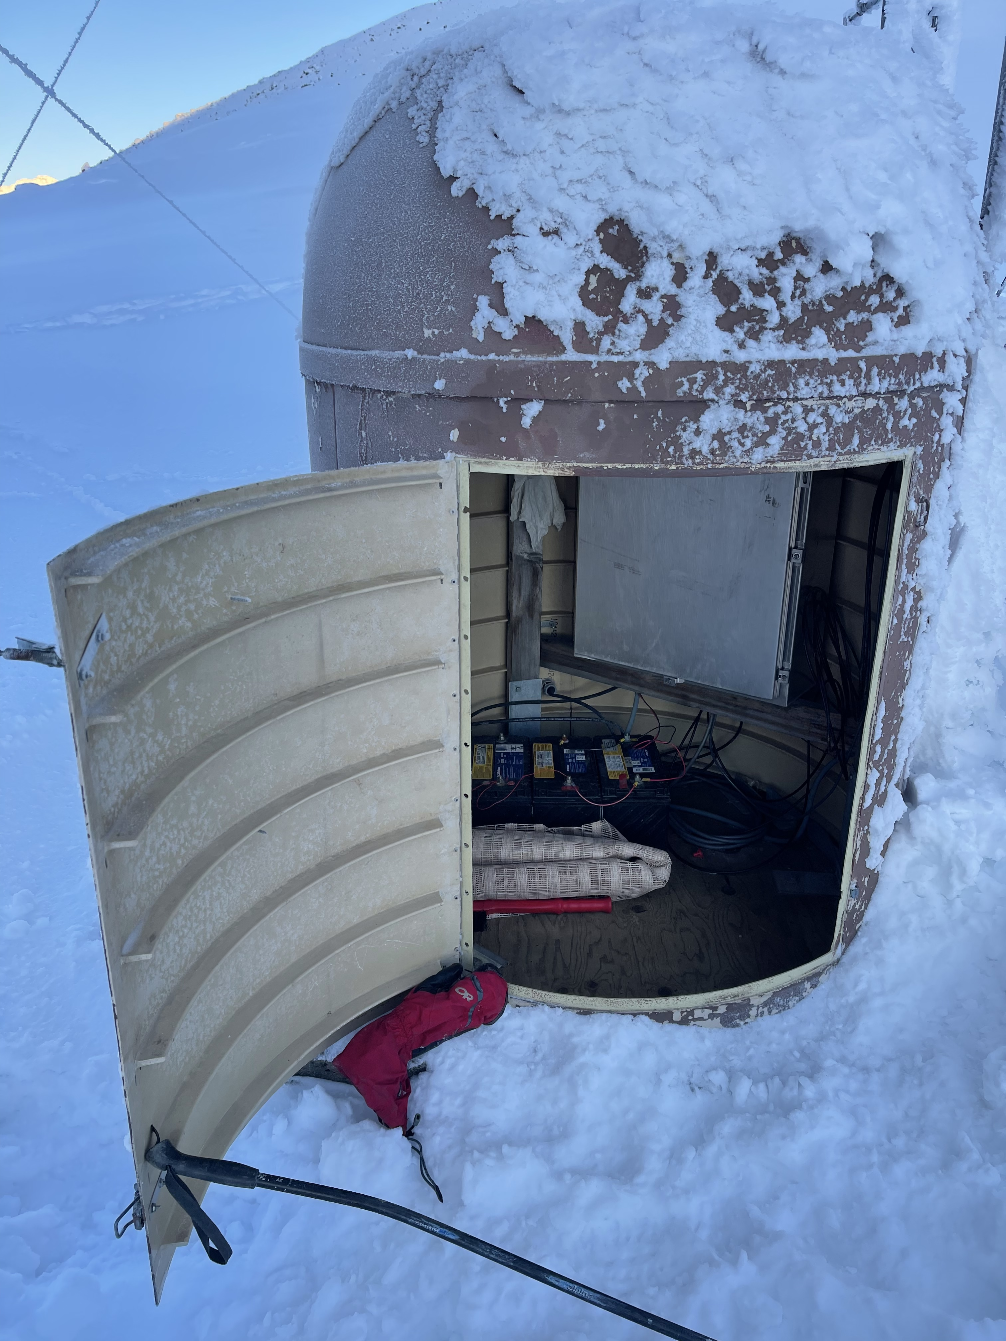

Slide 31
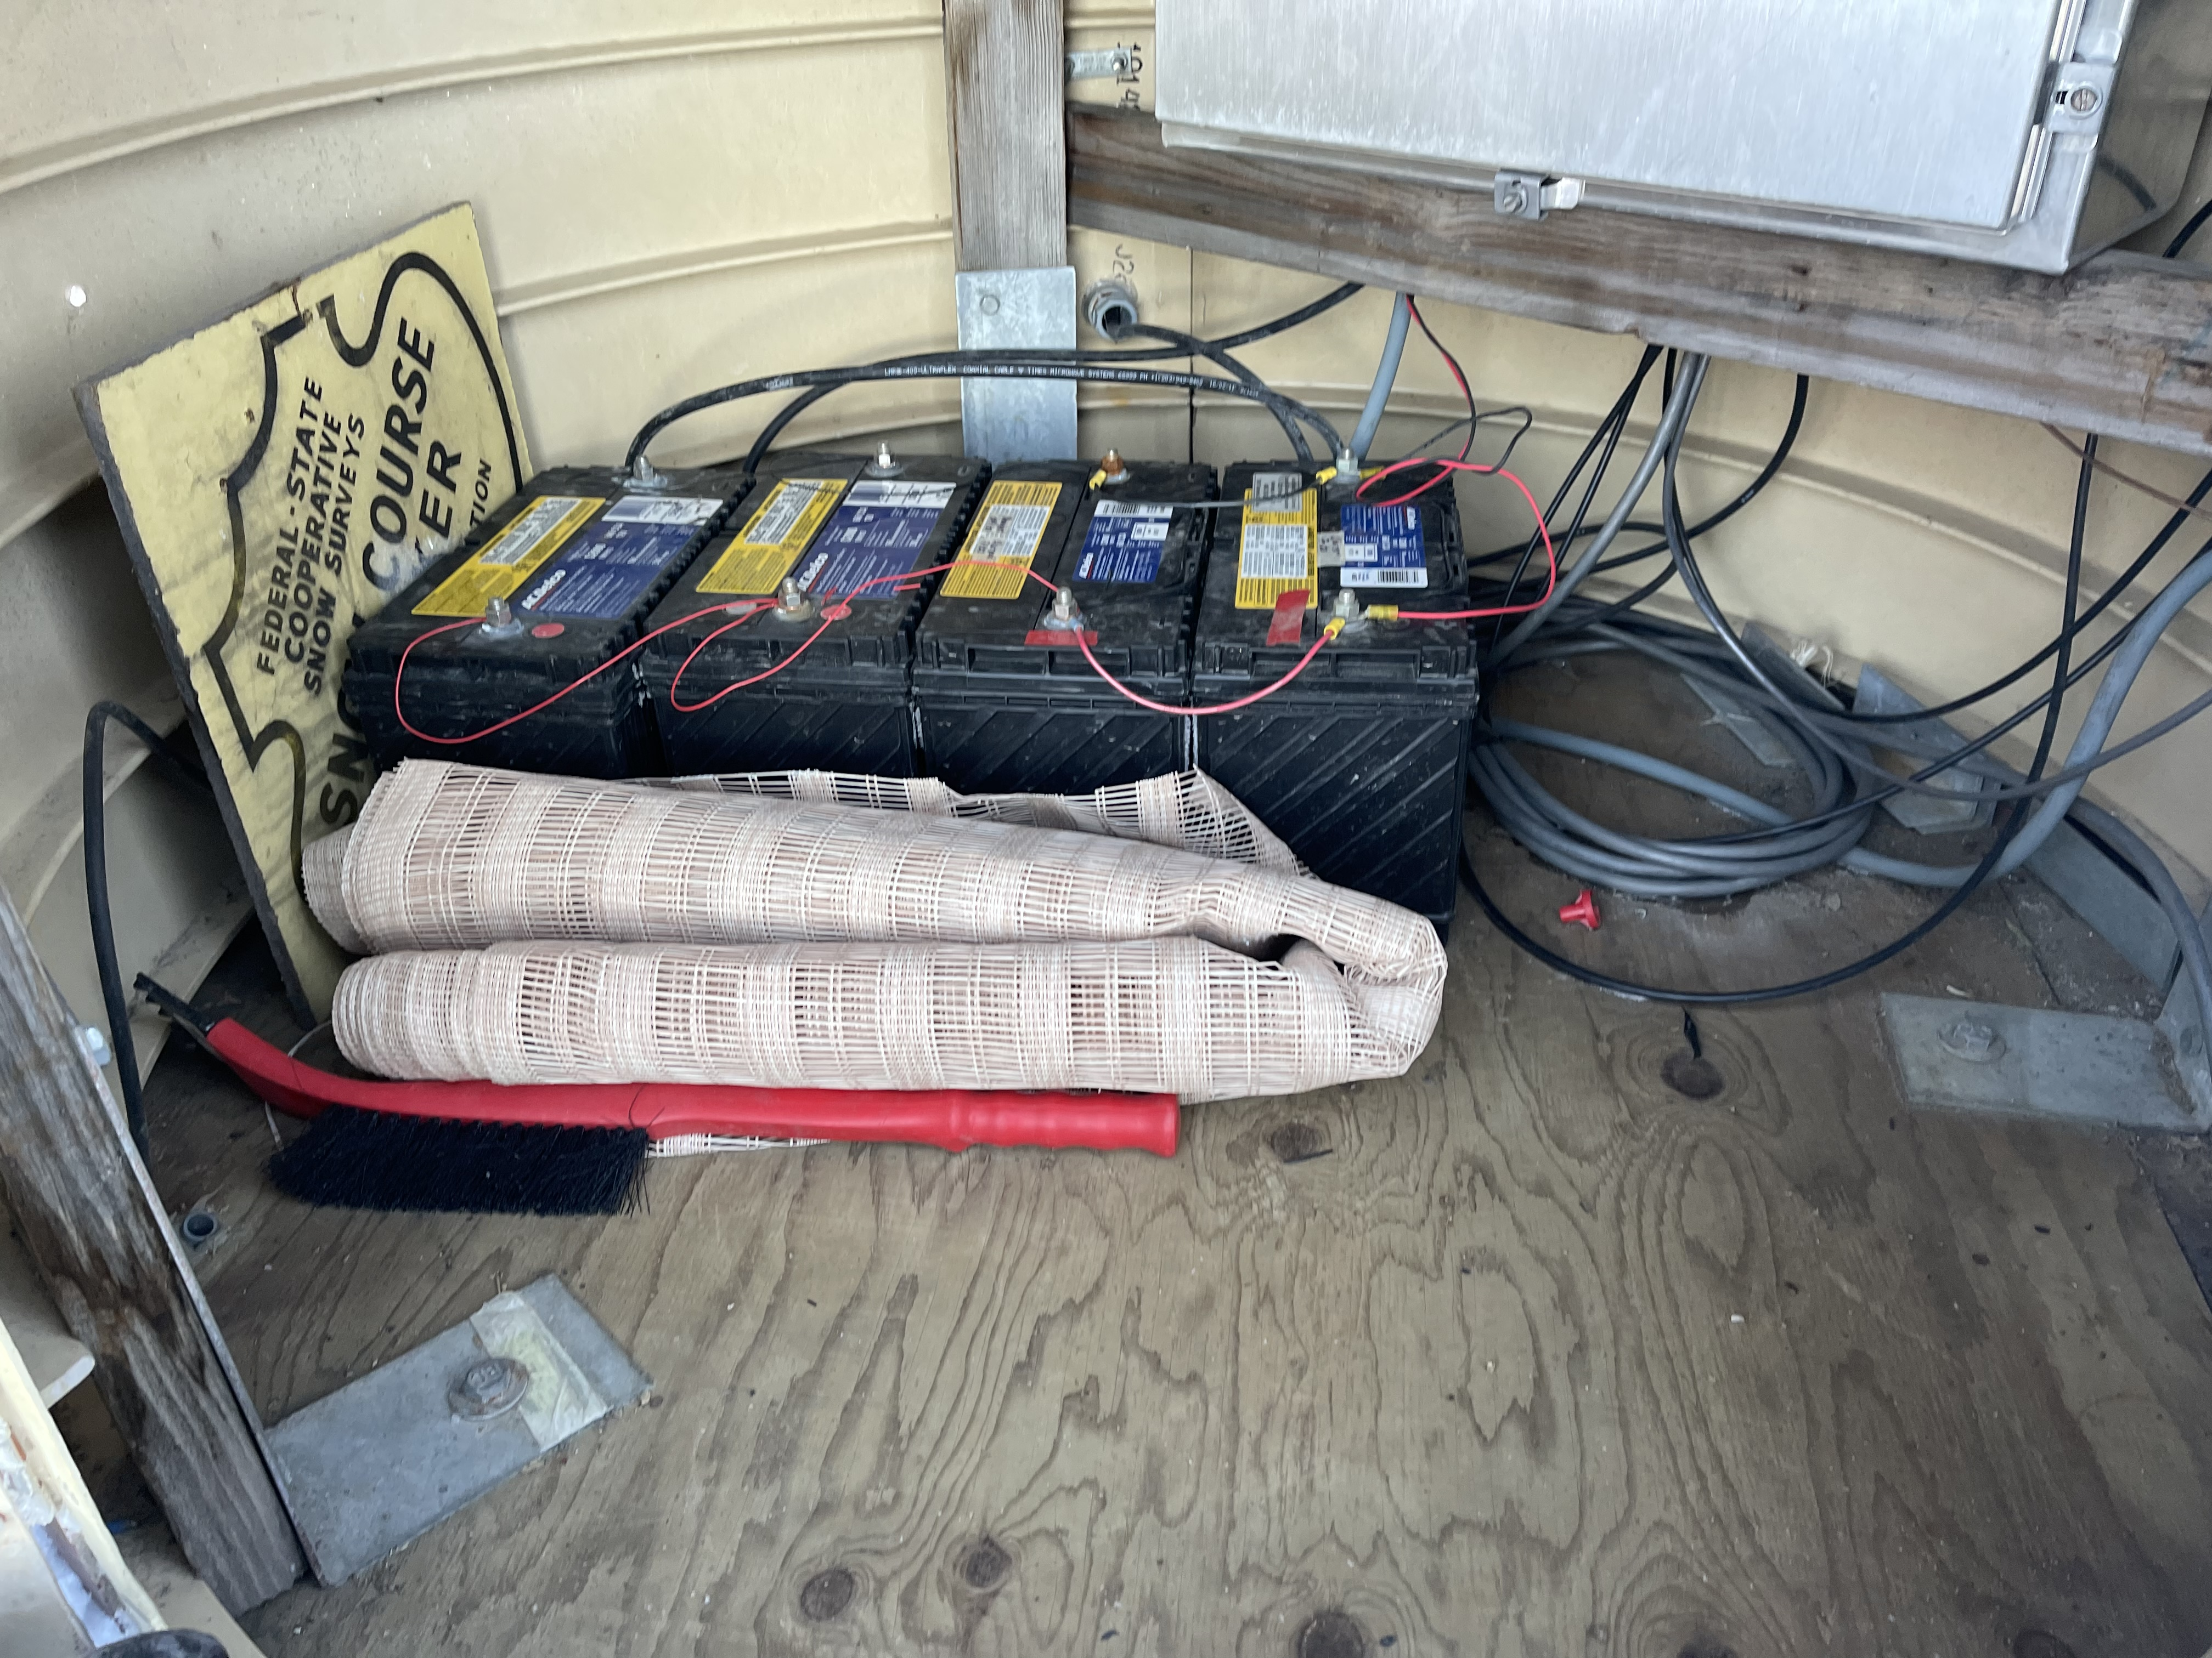

Slide 32
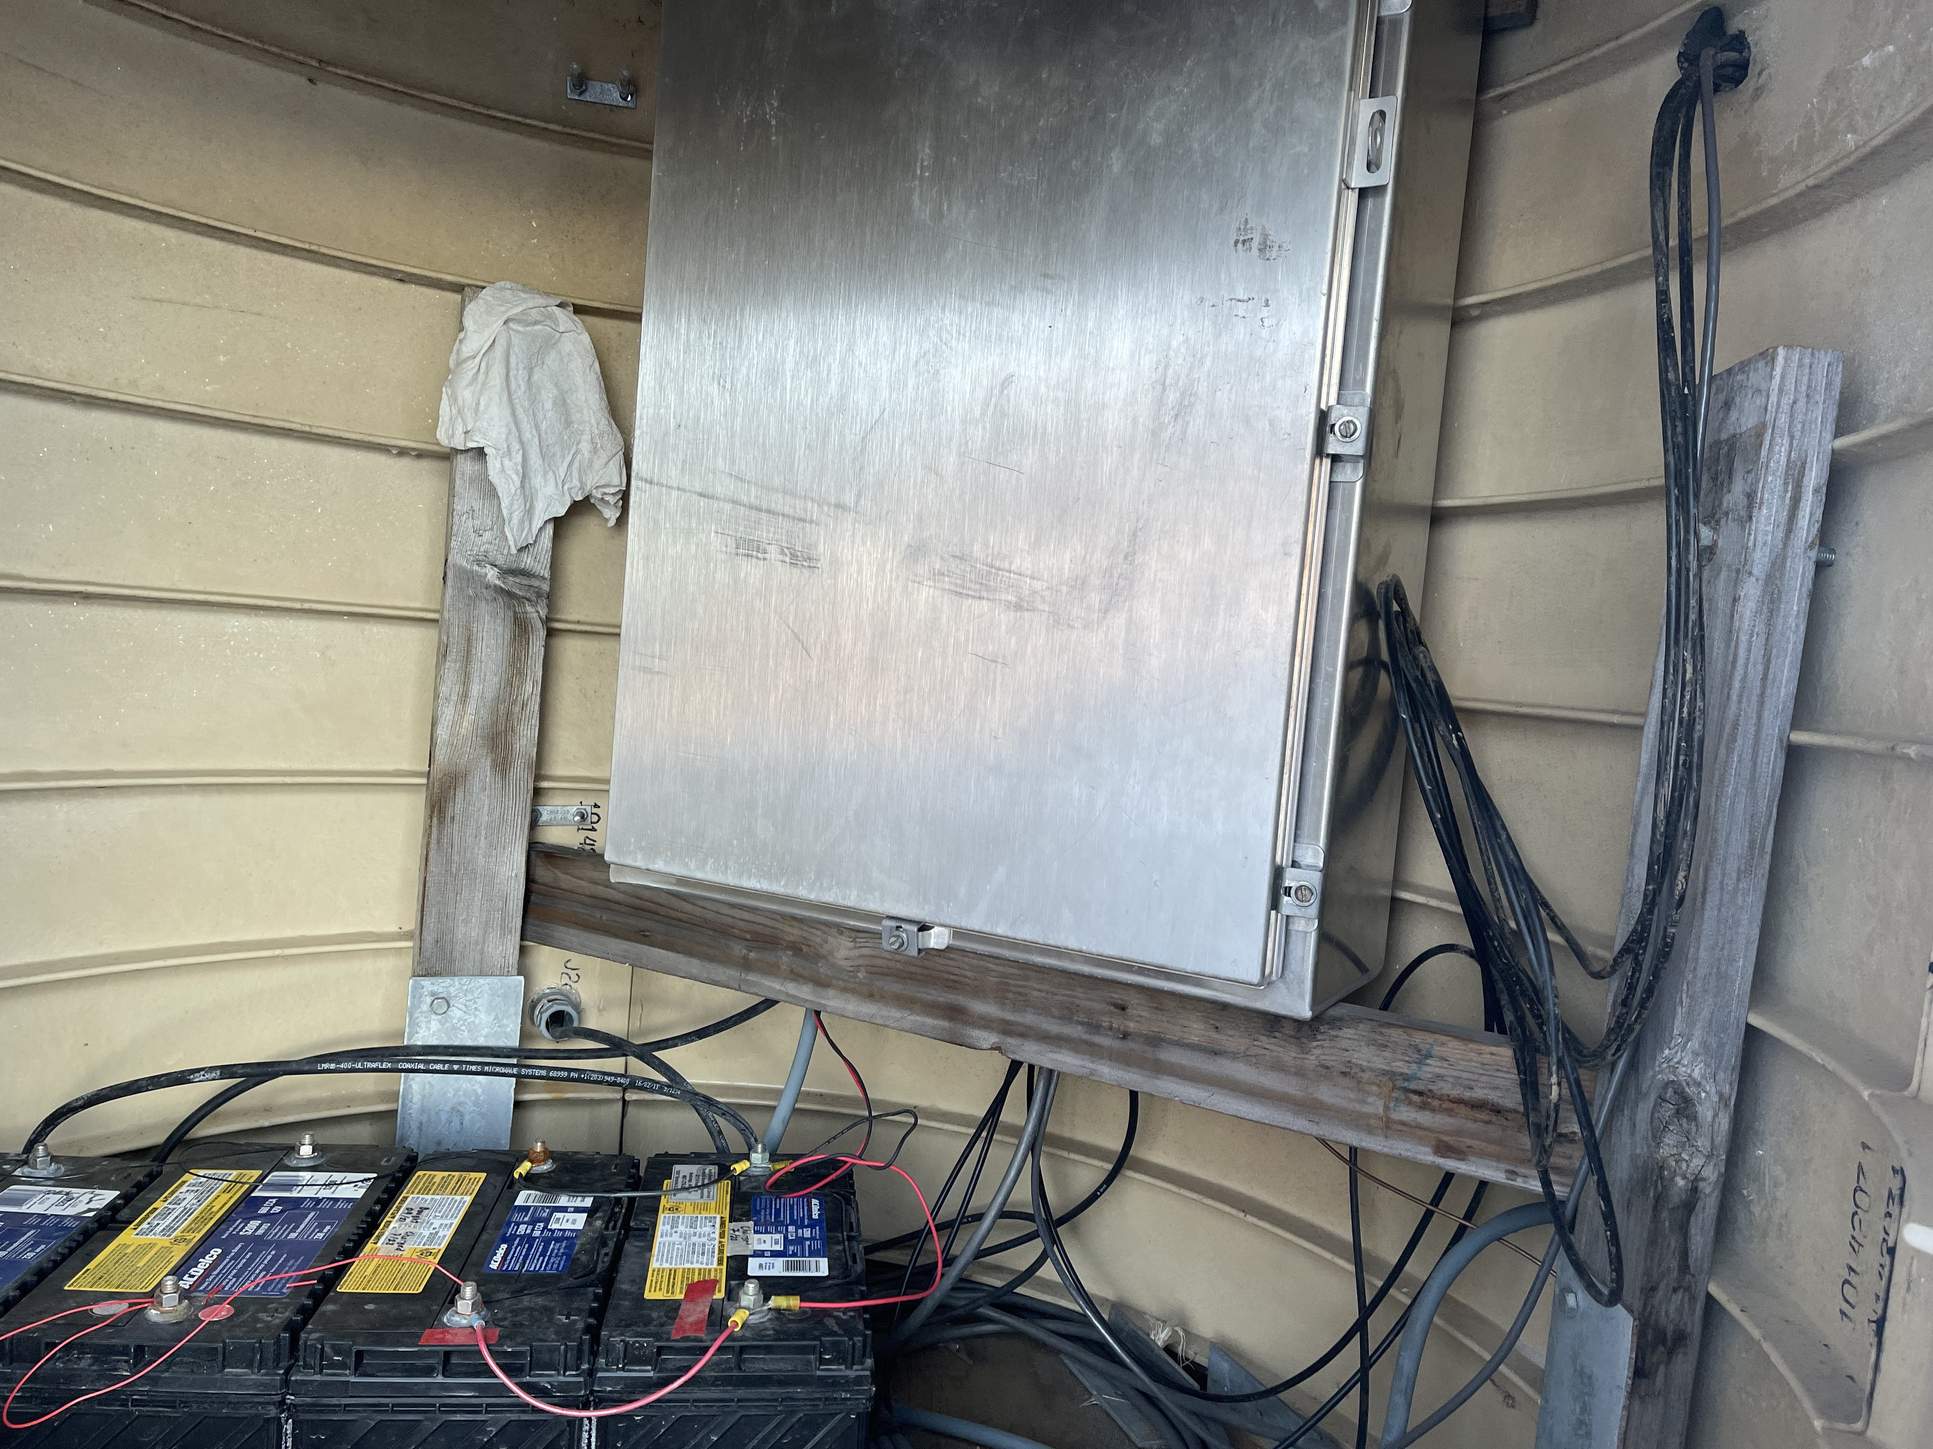

Slide 33
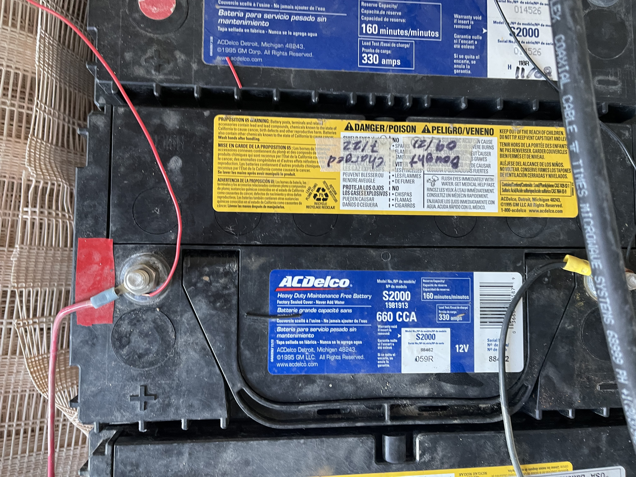

Slide 34
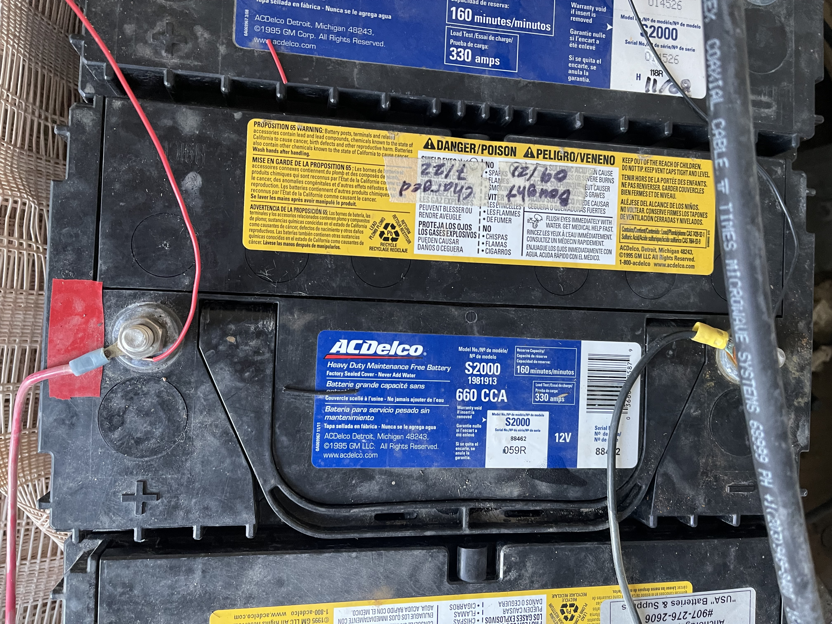

Slide 35
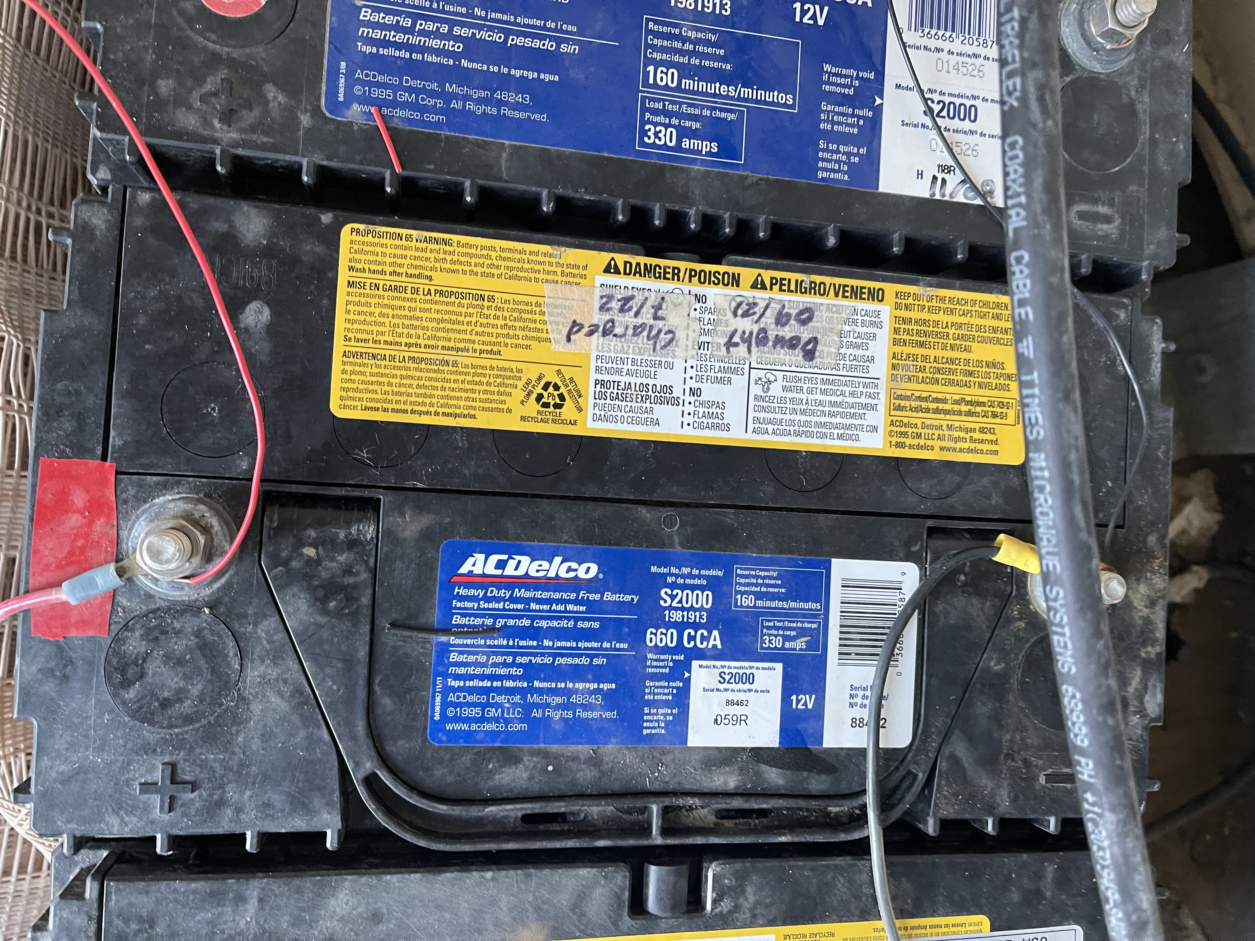

Slide 36
